Slide 1

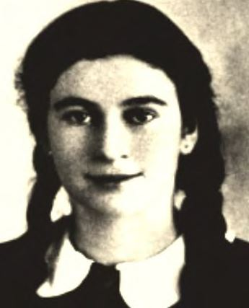
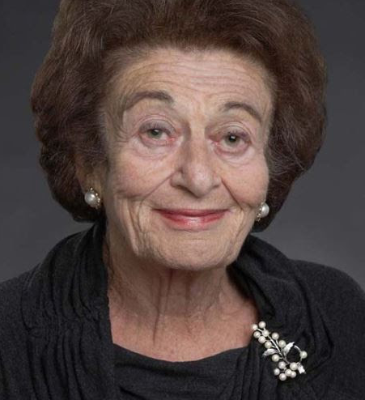
Profile Cards of Holocaust Survivors Who Made Their Home in the Greater Phoenix Area
(z”l means the individual has died)
Gerda was born to a Jewish family in Bielsko, Poland. She began her education in Polish public school but later entered a Catholic girls' school. A rabbi was permitted to come to the school and instruct the Jewish students in religious studies.
On September 1, 1939, Nazi Germany invaded Poland. German fighter planes appeared overhead, and many people fled Bielsko. Gerda's family remained and lived through the intense shelling that followed. The next morning, they heard people shouting "Heil Hitler!" and a black, white, and red swastika flag suddenly fluttered from a window across the street. The Germans occupying Bielsko forced Jews, including the Weissmanns, to give up their homes and move to a newly established ghetto.
In 1942, Gerda was deported to work in a textile mill In Bolkenhaln (Bolk6w), In southern Poland. At one point, Gerda was almost killed. She had fallen ill and went to the infirmary. A German supervisor, Mrs. Kugler, realized that there would be an inspection of the inmates, and she dragged Gerda back to the factory. Although Gerda was delirious from fever, she passed the inspection. Mrs. Kugler's actions likely saved Gerda's life. Gerda was later sent to slave-labor camps in Marzdorf, Landshut, and Gruenberg. She was liberated by the American army in May 1945 and immigrated to the United States in 1946 where she married Lt. Kurt Klein who was in the unit that liberated her.
Gerda, a longtime resident of Scottsdale, was an author, humanitarian, Academy Award and Emmy winner, and speaker. On February 15, 2011, Klein was presented with the Presidential Medal of Freedom, the highest civilian award in the United States. She died in 2022.
Gerda Weissmann Klein z“l
Born May 8, 1924
Bielsko, Poland
Phoenix Holocaust Association Arizona Jewish Historical Society

Slide 2
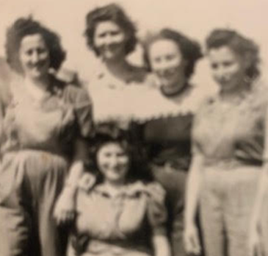
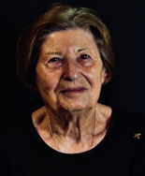
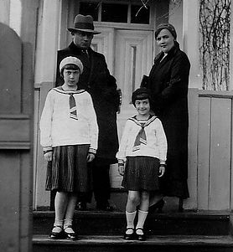
Rise was the fourth child in a family of six children. A primarily Jewish town, Velke Komyaty was at the base of the Carpathian Mountains in what was then Czechoslovakia, and most inhabitants were small farmers. In 1942, after Hungary took over the area, life became more difficult.
In late 1943, Rise went to a nearby town to assist a relative who had suffered a hip injury. Soon afterwards, Rise and her cousins were taken by SS officers to a ghetto. Rise would not see most of her immediate family again.
In 1944, Rise and her family were packed into cattle cars. When the train stopped at Auschwitz-Birkenau concentration camp, she was separated from her relatives and never saw them again.
At Auschwitz, her hair was shorn, a number was tattooed on her arm, and she was given a prison uniform. Shortly afterwards she was selected to dig trenches in Krakow. In October 1944, she was taken to Bergen Belsen to work in a potato field, where taking a potato could mean death. One of Rise’s last assignments was working in an underground munitions factory in a salt mine.
After liberation in May 1945, Rise was taken to Sweden to recuperate. In 1948, she was able to emigrate to the U.S., where she moved to Ohio, married an American and had a son. After her husband died, Rise moved to Arizona to be closer to her son. It is only recently that Rise has begun to tell her story of survival during the Holocaust.
Rise Stillman
Born: January 22, 1930
Velke Komyaty, Czechoslovakia
Phoenix Holocaust Association Arizona Jewish Historical Society
After graduating high school in Sarny, Bronia left to continue her education in Warsaw; she had wanted to be a doctor, but Jews were prohibited from pursuing medical school. In 1939, while Bronia was visiting her family in Sarny, Germany invaded Poland and Sarny was bombed. Within days, the Russian army entered Sarny, and overnight the town became part of the Soviet Union. Bronia repeated two years of school to be eligible for Soviet college.
In June 1941 Germany severed its pact with Stalin. Bronia, her mother and sister ran from Sarny, sometimes riding trains while being bombed and dodging bombs on the Dniepr River. Her father and other relatives stayed to wait it out. Sheer luck landed Bronia, together with her mother and sister, in Armenia, where she was accepted to medical school.
When Sarny was liberated, Bronia, her mother and sister returned, but there were no Jews; 18,000 had been shot into ditches, including her father and grandparents. Bronia left with her mother and sister in hopes of making it to America. First stop was Lublin, where she met and married Sana Bronkesh; a week later they left on a two-year journey, finally arriving in an American Displaced Persons (DP) camp near Munich. In June 1947, Bronia, Sana and their newborn daughter made it to New York City. Bronia and Sana, now known as Sam, moved to Scottsdale in 1991 after many years in New Jersey on a chicken farm. She died in 2015.
Bronia Cimmerman Bronkesh z”l
Born: April 21, 1921
Sarny, Poland
Phoenix Holocaust Association Arizona Jewish Historical Society

Slide 3
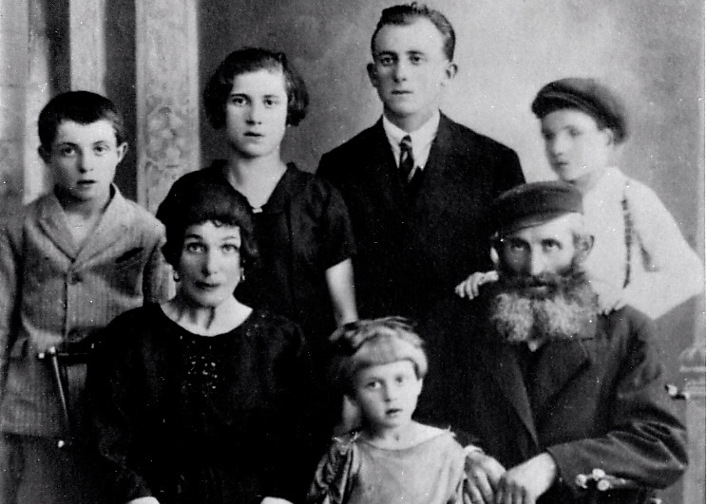
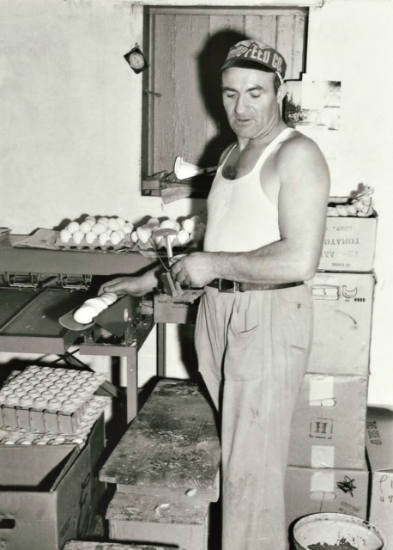
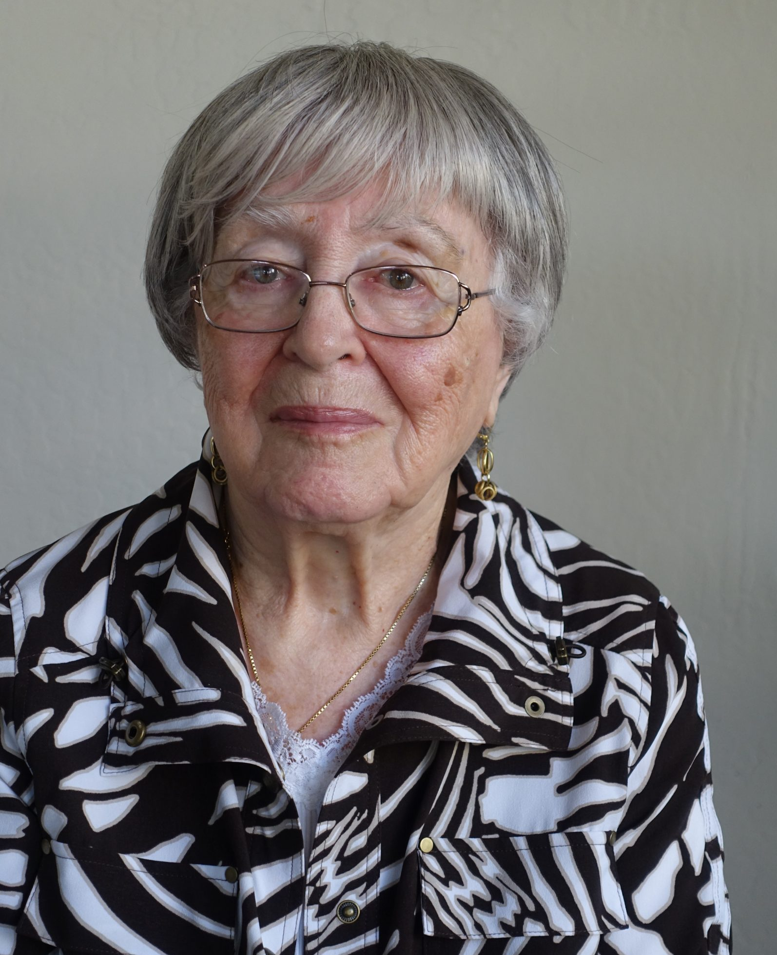
Sana was one of six children of Yisrael and Nesha Bronkesh. He worked alongside his father and brothers buying produce from area farmers and selling it in bigger cities. In March 1941, the Nazis established a Jewish ghetto in Ryki. Daily, Sana was marched to work in a munitions factory a few kilometers away. In spring 1942, he heard rumors the ghetto would be liquidated. Sana ran to Deblin, where his three brothers were in a work camp, and managed to bribe guards to release them. The four joined other young men from Ryki and fled to the woods, where their small partisan group survived for more than two years. Their sisters, mother, wives, and children were murdered in Sobibor.
In Sana’s own words, “We were living like mice and rats in the ground. We dug bunkers. Some days we got to eat, sometimes not. We blew up a bridge here, blew up the train there… then we’d go 30 miles in a different direction.” After Lublin was liberated, the brothers went to a homeless shelter; there, Sana met and married Bronia Cimmerman. They were smuggled through multiple countries until they reached an American DP camp near Munich. In June 1947, Sana, Bronia and their newborn daughter came to the United States, where Sana became Sam. After decades in New Jersey, first on a chicken farm and then in wholesale food distribution, Sam and Bronia moved to Scottsdale in 1991. He died in 1998.
Sam (Sana) Bronkesh z”l
Born: March 1914
Ryki, Poland
Phoenix Holocaust Association Arizona Jewish Historical Society
Until she was eight, Frieda lived with her mother, Sarah, and her father, Marcus, in Chortkow, where she spoke Polish at home and attended a Yiddish school. In 1939 the Hitler/Stalin pact divided Poland and Russia occupied Chortkow—until June 1941, when Germany broke the pact, invaded the town and began killing Jews. Marcus was conscripted into the Russian army, and Frieda and her mother began a six-month odyssey trying to stay ahead of the Nazis.
Taking only what they could carry, they boarded a train with other families on the run. They endured cold, hunger, fear, Nazi bombings, and overcrowded cattle cars. Constantly on the move, they went from Kiev to a collective watermelon farm near Stalingrad. Frieda survived scarlet fever and then typhus.
By sheer luck, Marcus was reunited with his wife and daughter in 1942. Until the winter of 1946 they lived in the Ural mountains of the Soviet Union where Frieda attended school.
After the war, Frieda’s family (which now included a baby sister) went to Germany and remained there until 1949. They lived in two displaced persons camps. After three years, the family immigrated to the U.S. and settled in Detroit, MI where at age 13, Frieda resumed her education. At 19, Frieda married another survivor and they had four children. Frieda has lived in Scottsdale since 2006 and for years was silent about her Holocaust experience. She has begun to speak to groups because she believes that those who survived the Nazi era in many different ways must tell their stories.
Frieda Allweiss
Born: May 21, 1933
Chortkow, Poland
Phoenix Holocaust Association Arizona Jewish Historical Society

Slide 4
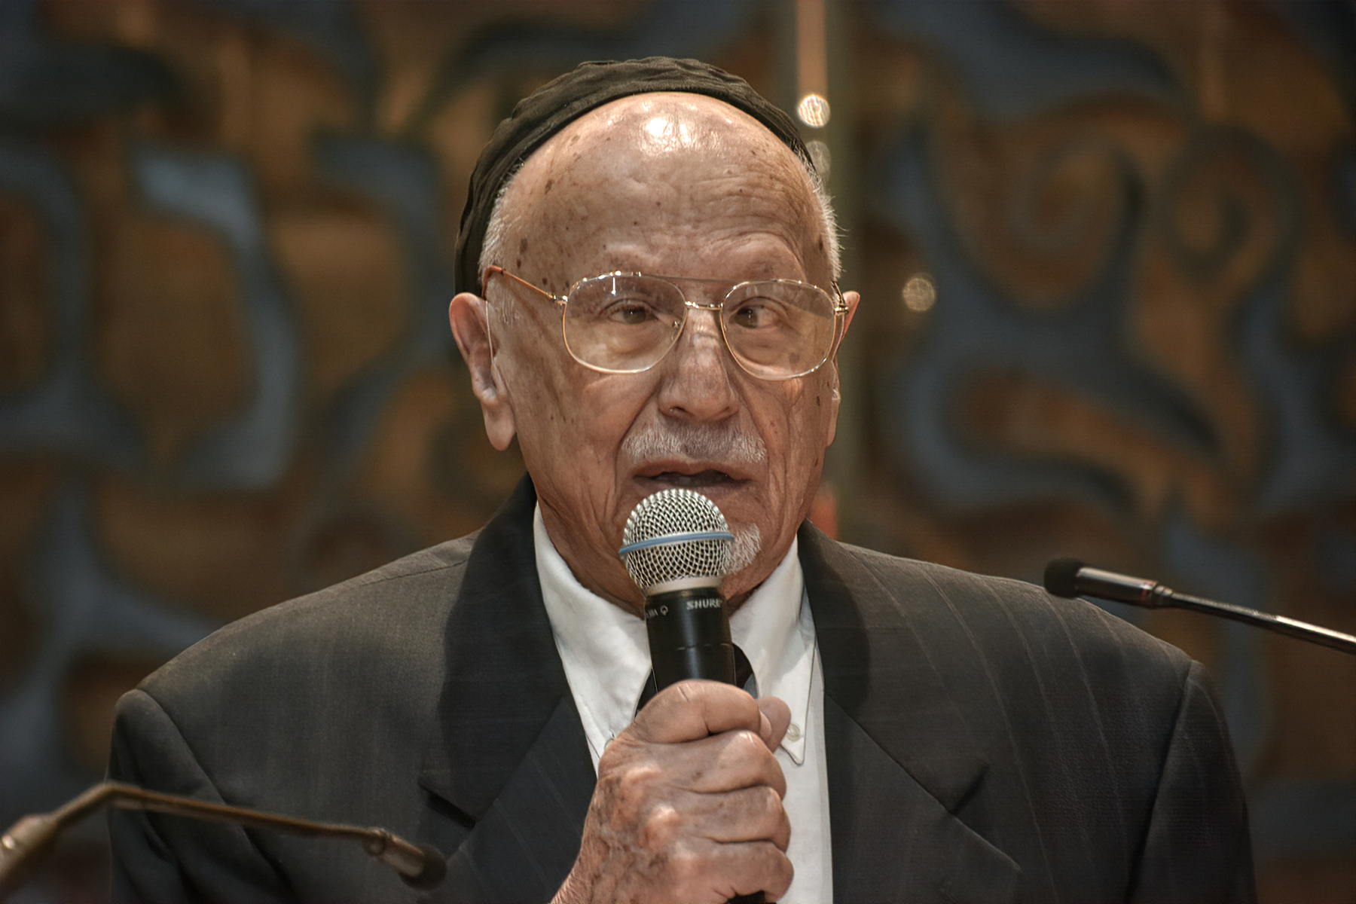
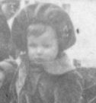
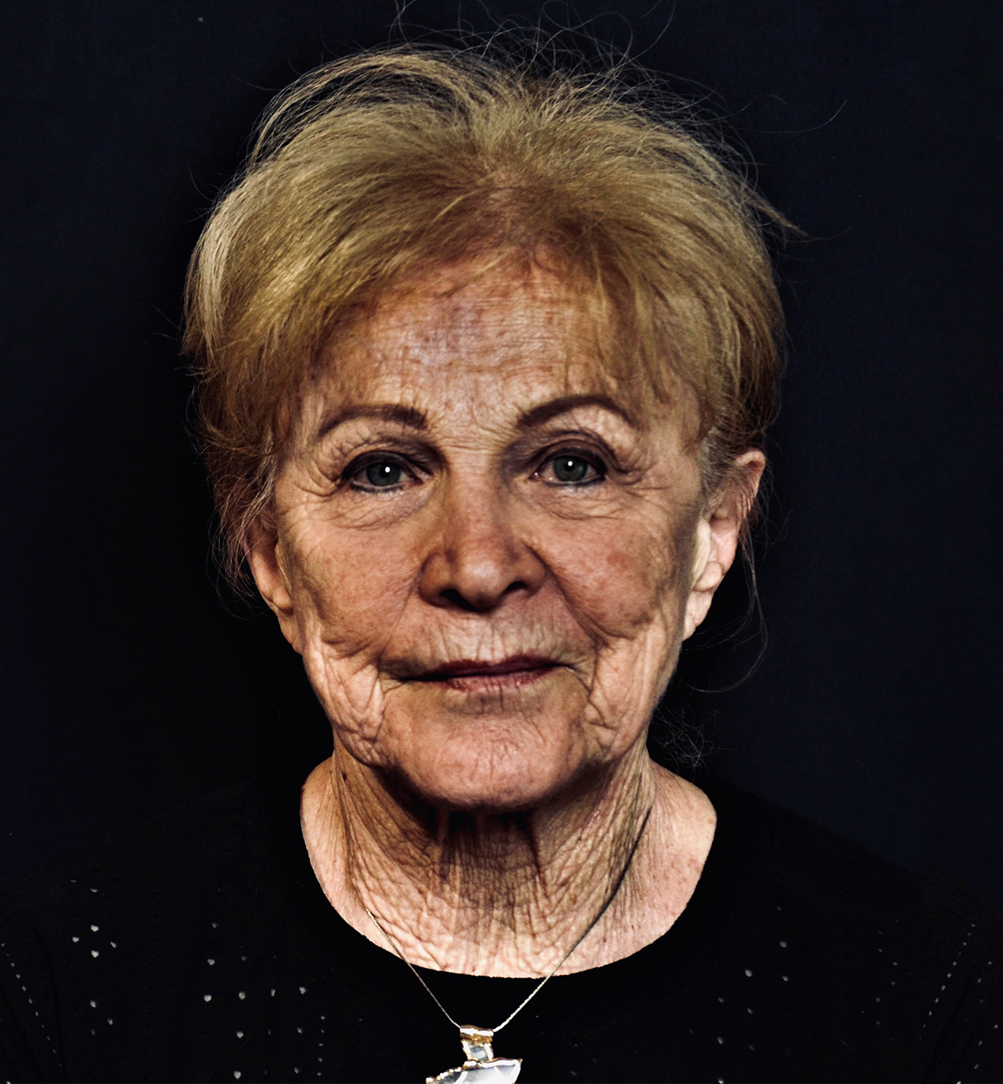
George Kalman grew up in a farming village where houses were built with mud bricks and had no running water, and no indoor bathrooms. Hungary was an ally of Germany during WWII, and military-aged Jewish men, including his father and two uncles, were conscripted into slave labor. George last saw his father when he was just seven.
At the age of nine, George, along with his mother, grandfather, and 80 other Jews from the village, was crammed into a railway cattle car and deported. The group ended up in Neudorf, Austria, in an agricultural slave labor camp. Only 35 Jewish prisoners were in this small camp. Kalman’s mother worked as a maid for a high-ranking Nazi official, and George took care of farm animals and harvested vegetables.
After liberation by the Russian army on April 2, 1945, they returned to their village and reunited with an uncle who survived the war. George’s father and other uncle had been murdered. Soon after the end of the war, Hungary—like most countries in Eastern Europe—became a communist dictatorship. In 1956, a revolution in Hungary gave George a chance to escape.
He emigrated to Canada, eventually learned English, finished university, married, and had two children. George moved to the U.S. in 1968 for a job with Westinghouse Electric to do semiconductor research. George retired in Phoenix, where he spoke frequently to students and teachers on his experiences during the Holocaust. George died in 2021.
George Kalman z”l
Born: October 1934
Szeghalom, Hungary
Phoenix Holocaust Association Arizona Jewish Historical Society
Born Mania Sztajman, Marion was just 18 months old when her parents realized the only way to save her was to hide her as a non-Jew. A Polish family agreed to take Mania until it was safe for her to return to her own family.
Weeks later, the ghetto where her parents were was overrun. Her mother, 25, and most of the extended family were sent to Treblinka, where they were murdered. Her father, Meyer, became a slave laborer in Starhovitz, and then was taken to Auschwitz and then Buchenwald.
Meanwhile, the Polish landowner’s wife claimed Mania was her niece. After a visit by the Gestapo, prompted by rumors the family was harboring a Jewish child, the woman told her carriage-driver to take the child away. He left her in a ditch next to a convent, where she was taken in as an orphan. Hungry and scared, Mania spent three years in the convent until it was bombed in 1945. A second convent took her in.
Mania’s father was liberated from Buchenwald on April 11, 1945 and returned to Poland to find Mania. Once he located the convent, the nuns hesitated to let a Jew in. He was persistent. They lined up all the girls facing a wall. It had been four years since had seen his daughter, but Meyer identified Mania by a distinct birthmark on the back of her leg. Only after paying money was he allowed to take Mania.
Meyer and Mania snuck across the border into Germany with his two sisters and brother-in-law to a Displaced Persons camp. After three years, they secured Canadian visas and moved to Toronto, where Mania was renamed Marion. Marion is an active speaker on the Holocaust in the Valley.
Marion Weinzweig
Born: January 3, 1941
Opatow, Poland
Phoenix Holocaust Association Arizona Jewish Historical Society

Slide 5
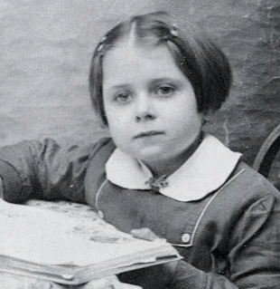
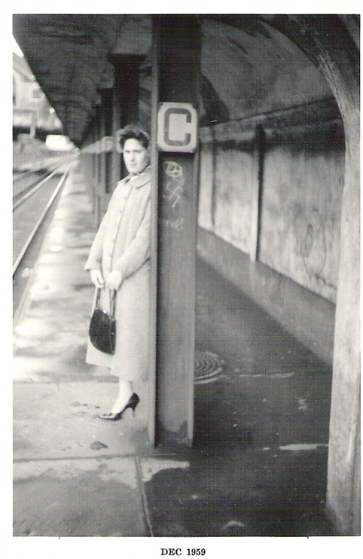
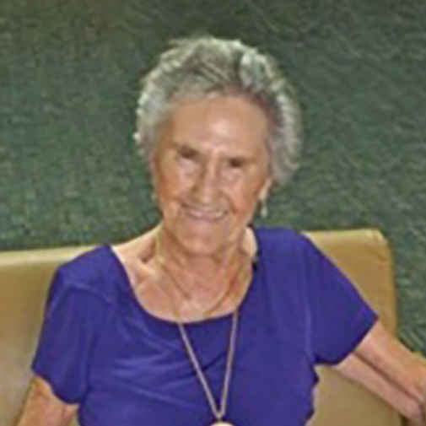
Charlotte Rozencwajg lived with her parents, both tailors, and younger brother, Max, in Paris. When Nazi Germany occupied France in 1940, Charlotte, 8, was forced to wear a yellow Star of David, forbidden from attending movies, and ordered to sit at the back of classrooms and trains. Before the 1942 Ve' d'Hiv mass arrest of Parisian Jews, neighbors hid the family.
When hiding became impossible, Charlotte's parents took both children to an orphanage to protect them. Collaborators informed the Gestapo, who arrested Charlotte’s parents, loading them onto trucks. Her father jumped off the truck and went into hiding, but her mother was too scared and was deported to Auschwitz, where she was murdered. Charlotte's father, who was working as a tailor in Eastern France, sent for Charlotte. Months later, they fled into the woods, pursued by Nazis with killer dogs. Charlotte's father then asked a courageous woman, Madame Quatreville, to hide his daughter while he joined the French underground. After nine months spent hiding in a cellar, the war ended and Charlotte, now 13, was reunited with her father. With the help of the International Red Cross, he was able to locate Max.
Eventually Charlotte moved to Montreal, Canada, then immigrated to the U.S. Today she lives in Phoenix, where she is an active speaker on the Holocaust.
Charlotte Rozencwajg Adelman
Born: March 26, 1932
Paris, France
Phoenix Holocaust Association Arizona Jewish Historical Society
Esther was the only child of Rabbi Moises and Fanny Roth. Esther grew up a tomboy, playing in the mountains, picking walnuts, and climbing trees with both Christian and Jewish friends. Though she heard of the horrors happening to the Jews in Germany, her isolated town seemed far from the war.
When the German army entered her village in early 1944, Esther was no longer allowed to go to school and her Christian friends turned against her. Esther and her family were forced into the ghetto, where they lived with five other families in a two-bedroom house. From her window, Esther could see her former home being ransacked by their neighbors. In May 1944, Esther and her parents were taken to a train station and forced into a cattle car with no water or food. On her 16th birthday, they arrived at the Auschwitz concentration camp, where Esther was separated from her parents. She never saw them again. Esther spent several months in Auschwitz. There she crossed paths with Josef Mengele, known as the Angel of Death. To this day, Esther has nightmares about Mengele.
In April of 1945, Esther was sent to work at an ammunitions factory deep in Germany. To get there, she took part in a death march, walking for days. Upon arrival, she found 3,000 women there. Three days after she got there, the camp was liberated by the American army. After three months, the women were put on trucks and taken to a port, where they boarded a ship bound for Prague, then a train to Budapest, where she met her husband-to-be, Joe. Eventually they would move to Palestine and later to Canada. After many years in Phoenix, today Esther lives in Prescott with her daughter and frequently speaks to students.
Esther Roth Basch
Born: May 28,1928
Szollosh, Czechoslovakia
Phoenix Holocaust Association Arizona Jewish Historical Society

Slide 6
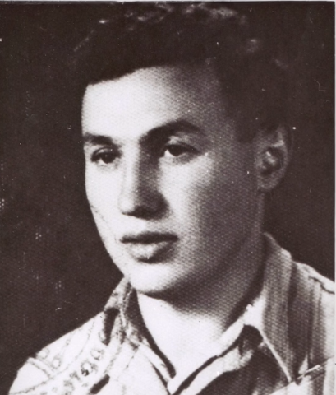
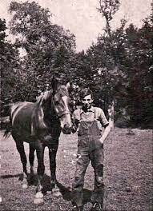
Alex lived with his parents and three siblings. His schooling ended abruptly when Nazis invaded Poland and occupied Krosno. Alex's family found temporary refuge in Dynow, but the SS took all Jewish males between 16 and 60 and shot them. His father was spared because he had returned to Krosno to rescue some family possessions; when asked by an armed soldier how old her son was, Alex’s mother answered 14, thus sparing Alex's life.
The family endured two years of forced labor, starvation, curfews, and shootings. In 1942, the order came for liquidation and "resettlement" of the ghetto. Two dozen Jews, including Alex and his father, were assigned to an airbase to work for the Luftwaffe. The remainder of his family was killed. In May 1944, his father was sent to the gas chamber, leaving Alex the sole survivor of his immediate family. As Soviets approached, the Nazis tried to hide evidence of their atrocities. Alex was ordered to open the mass graves in Krakow-Plaszow concentration camp and burn the corpses. He was then taken to Gross Rosen, the most brutal of the camps he experienced. Then he worked in an ammunitions factory, until he was liberated on May 8, 1945. Alex was number 269 on Oskar Schindler's list, made famous by the Steven Spielberg film.
After the war, Alex made it to the American zone in Germany. There he studied medicine and, in 1950, came to the U.S., where he continued his training and joined the U.S. Army. Alex retired in Arizona, where he implored students not to be indifferent, to get an education, and to be a mensch (Yiddish for a person of integrity and honor).
Alex died in 2022.
Alexander Bialywlos White z”l
Born: June 1923
Krosno, Poland
Phoenix Holocaust Association Arizona Jewish Historical Society
Oskar was in third grade in 1935, when the Nuremburg Laws were enacted, forbidding Jewish children from attending school. Because his parents were Polish citizens, the family, including a sister and brother, were forced to leave Germany. They settled in Krakow, Poland, where Oskar returned to school until September 1, 1939, when Germany invaded Poland. The Nazis soon imposed new restrictions on the Jews, including wearing a Star of David.
In March 1941, a walled ghetto was established, and Oskar's family was assigned one room. Nazis soon began deporting Jews to forced labor and killing camps, until the ghetto's liquidation in March 1943. Oskar's mother was sent to a slave labor camp while Oskar, his father and siblings, along with other skilled Jews, were taken to Gestapo headquarters to service 500 German officers. Oskar shoveled coal in the boiler room and his sister knit dresses for Nazi wives. Oskar's father was murdered. On Jan. 17, 1945, Oskar and his siblings escaped, missing a deportation to Mauthausen Concentration Camp. The next day the young Knoblauchs were liberated by Soviet troops.
In 1949, after four years in Feldafing, a DP camp, Oskar and his mother went to Canada. He moved to the U.S. in 1953 with his wife.
Oskar is a frequent speaker throughout the Valley. Oskar wrote about his experience in “A Boy's Story, a Man's Memory: Surviving the Holocaust 1933-1945.”
Oskar Knoblauch
Born: November 27, 1925
Leipzig, Germany
Phoenix Holocaust Association Arizona Jewish Historical Society

Slide 7
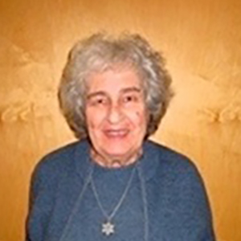
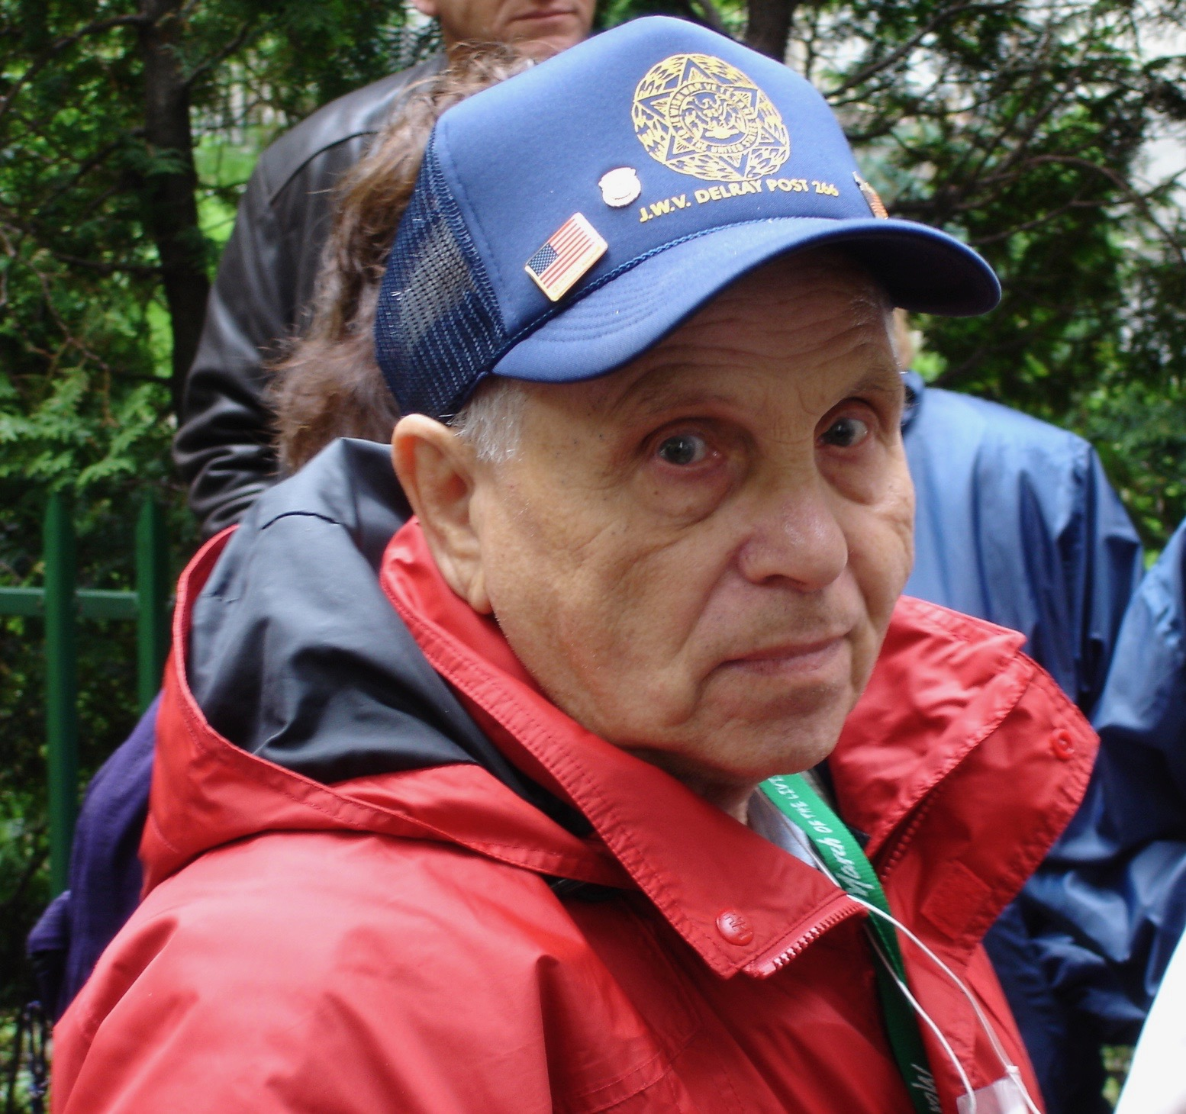
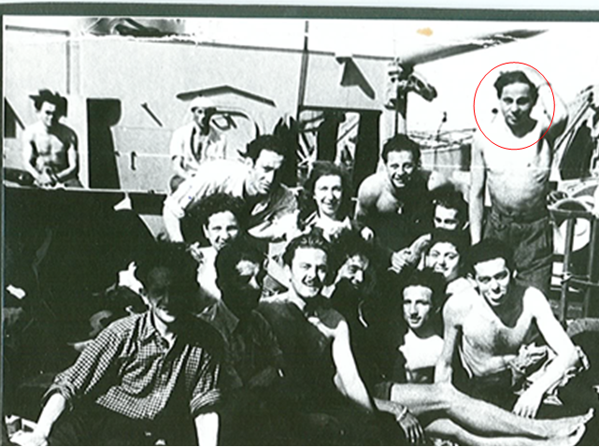
While Julie was born in Vienna, Austria, her father was originally from Tarnapol, Poland, and her mother from Vishnitz, Romania. As the father worked as an attorney in a bank, the family was well-off, and Julie was a self-admitted “spoiled only-child” with maids, nannies, tutors, and private schools.
Everything changed in the spring of 1938, when Hitler entered Austria and a great many restrictions were placed on the Jews. On Kristallnacht, Nov. 9-10, 1938, Julie and her mother hid in the closet of their apartment while her father rode a streetcar all night. What he saw convinced him the family needed to flee. Her father lost his job. Six months later, the family received permission to go to Antwerp. Jews were not permitted on trains, so they flew to Belgium in a non-pressurized old plane—with oxygen masks. Once in Belgium, Julie attended a Flemish school.
Escape to Shanghai was considered, but after an influential friend in Chicago helped arrange papers for the family, they changed their plans to emigrate to the U.S.—only after stating they were farmers, as that was the preferred profession to get a visa. HIAS supported the family, finding them an apartment in New York; later they moved to Chicago near their friend. Her father retrained as a bookkeeper. Her mother worked as a cook in a cafeteria. Julie had to make up the gap in her education by attending summer school. She eventually attended college and became a medical technician. She met her husband, a survivor from Poland, on a blind date. They married in 1954 and had three children. In 2009, Julie moved to Phoenix, where her son lives.
Julie Gutfreund
Born: October 19, 1931
Vienna, Austria
Phoenix Holocaust Association Arizona Jewish Historical Society
Morris, born Moniek/Moishe Frajbaum, had three siblings. His father managed a cabaret restaurant; his mother was a homemaker. The family, including Morris’ maternal grandmother, lived in an apartment near the Nozyk synagogue. His paternal grandparents as well as aunts, uncles and cousins also lived in Warsaw.
Morris attended Polish public school. He remembered mostly peaceful relations between Jews and non-Jews, except on Sundays when, after church, some Poles would get drunk and go “Jew hunting.” Morris stayed off the streets on Sundays.
In 1939, when Germany invaded Poland, Morris was 12; his schooling ended, and he never became a bar mitzvah. His family was enclosed in the Warsaw Jewish ghetto. Additional families were forcibly moved into their two-room apartment. Dire conditions led Morris to escape the ghetto to buy or barter for food in the “Christian quarter.” Once, on a smuggling run when he was 14, he couldn’t safely return home. He never saw his family again. For weeks Morris tried to avoid capture by the Nazis but was finally discovered and sent to Radom. There he spent two years in a slave labor camp, was evacuated on a forced march to Tomaszow, sent to Auschwitz, then to three concentration camps in Germany—Vaihingen, Hessental and Dachau—before being liberated, at the age of 18, on a death march near Garmisch-Partenkirchen, on May 2, 1945.
Morris was the only member of his family to survive the Holocaust. He emigrated to the U.S. in September 1946. He lived, worked, married and raised a family in New York City, retired to Florida, and moved to Arizona shortly before his death at the age of almost 91.
Morris Friebaum z”l
Born: March 7, 1927
Warsaw, Poland
Phoenix Holocaust Association Arizona Jewish Historical Society

Slide 8
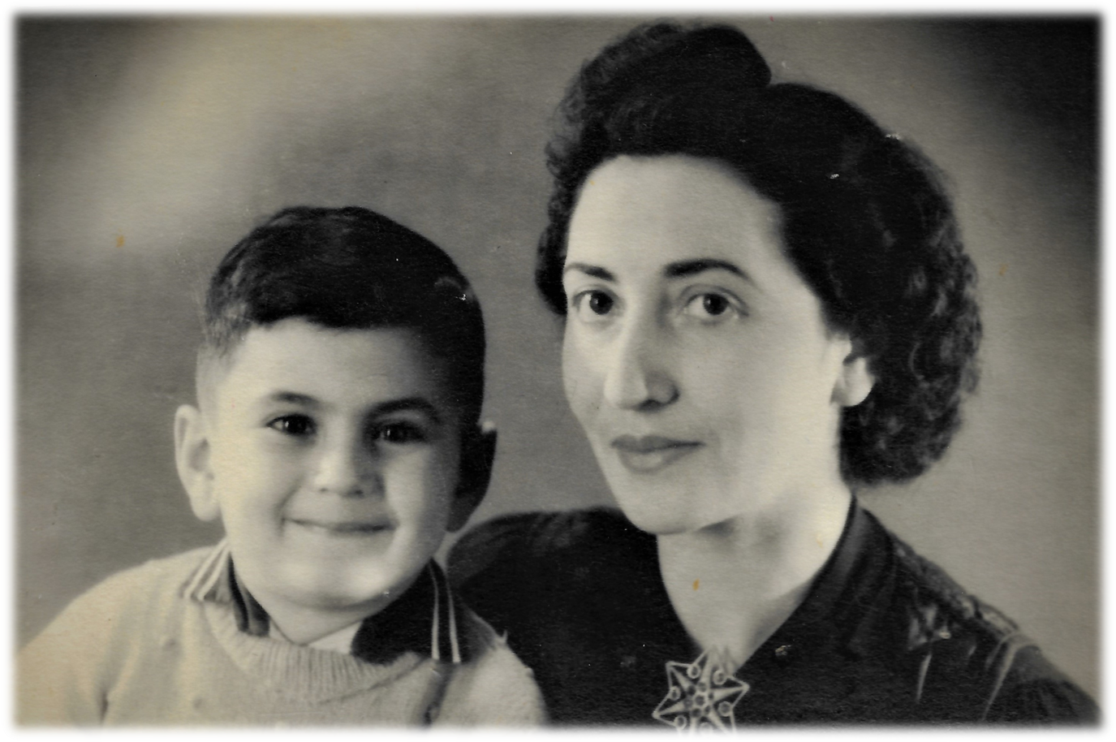
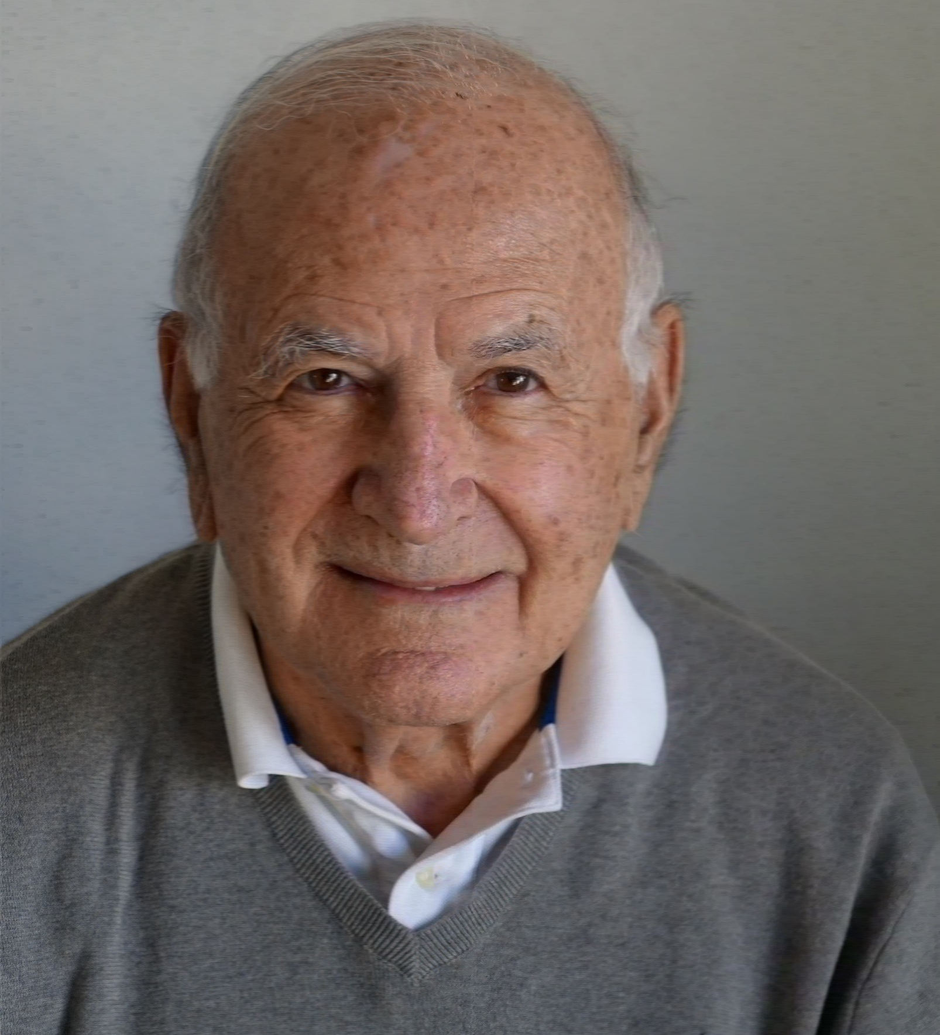
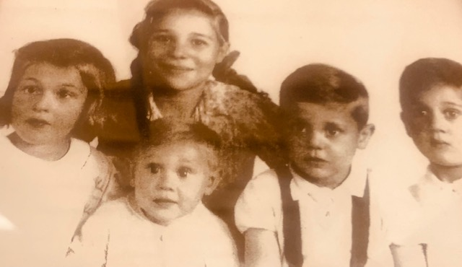
Phil was born after the start of WWII. For a year or so, Phil’s family was still able to live a normal life. However, in 1942 his parents were taken by the Germans and gave Phil to a neighbor. Shortly thereafter he was taken by a university student, by bicycle, to a place called Kids Haven, which was a home for unwed Dutch women who were pregnant by German soldiers. Kids Haven was very small, and a non-Jewish woman who worked there offered to take Phil to her mother, to see if she would take him in. Her mother had four daughters and felt that taking a Jewish child would put them all in danger. When the mother found out that he had the same name as her husband who had recently died, she said, “God took one Phil away, and sent me another one.” Phil stayed with the family throughout the war and remained close to his Dutch family. The family was recognized by Yad Vashem as Righteous Among the Nations.
Phil’s mother and sisters survived the Holocaust, but his father died on the day the camp was liberated.
Because Phil was so young when separated from his mother, he didn’t recognize her when she came to get him after the war and was afraid to go with her. Eventually his youngest Dutch “sister” went with him to help with the transition.
After the war, Phil’s mother remarried, and the family moved to Canada. He eventually reunited with other family members who had survived the Holocaust, including his sisters, an uncle and a cousin. Phil lives in Scottsdale and often speaks about the Holocaust.
Phillip Speyer
Born: May 30, 1940
Amsterdam, Netherlands
Phoenix Holocaust Association Arizona Jewish Historical Society
Dirk was born after the start of WWII to a Jewish mother and non-Jewish father. Dirk’s father was responsible for saving thousands of Jewish people from the Nazis. His father brought many people to hiding places on farms, where they had more food than was available to them in the ghettos. Only a very few of these farms were successfully raided by the Nazis. A warehouse where bicycles were rented served as the center of the resistance. Some of those being smuggled into hiding were hidden in the bicycles’ baskets, under a layer of things such as fish heads, which discouraged the Nazis from looking very closely.
Dirk’s father created counterfeit food coupons and other documents, which he had Dirk carry on the back of his bicycle. If they were stopped by German soldiers, at a signal from his father, Dirk would create a fuss, which would lead the soldiers to let him go.
The Nazis eventually found out that Dirk’s father was helping Jews and arrested him. Dirk’s family was put on a train for a four-day trip to a Bergen-Belsen, with no food, water, or toilets. Many people died on the way. The camp was liberated the day after Dirk arrived there. However, his aunts, uncles and all but two of his cousins had died in the camps. The only two who survived had figured out a way to escape from the train taking them to the camp.
Dirk has written three books about his and his family’s experiences, and still travels back to the Netherlands. Dirk lives in Scottsdale and often speaks about the Holocaust.
Dirk van Leenen
Born: 1940
The Netherlands
Phoenix Holocaust Association Arizona Jewish Historical Society

Slide 9
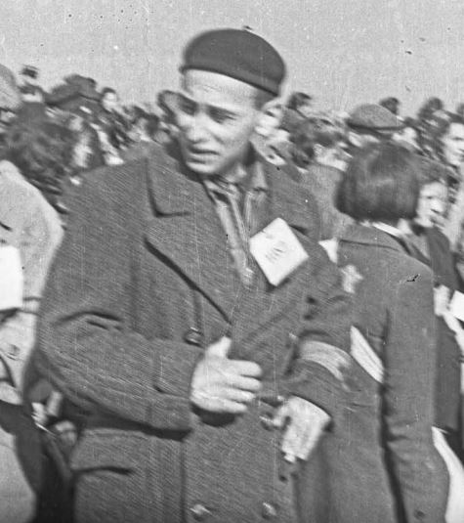
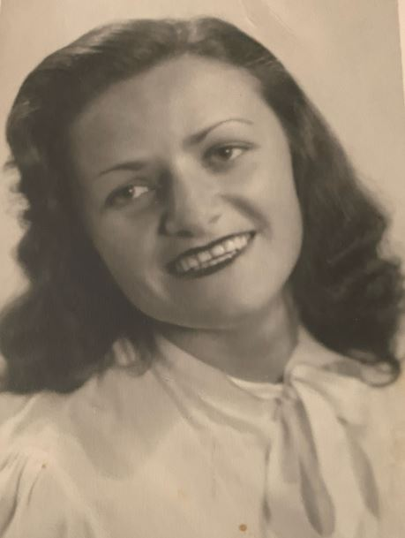
Daniel Geslewitz was born Gedalia Geclewicz in 1924 to Itzhak Geclewicz and Mirla Weitz. Daniel had six siblings: Mayer, Haya, Hirsch, Leon, Shmiel and Laya. Daniel was the youngest. All were murdered by the Germans except for Leon and Daniel. Itzhak and Hirsch died in the ghetto. Daniel also had a five-year-old nephew, Yosel, who was sent to the gas chambers in Auschwitz along with Mirla and his mother, Haya. Daniel’s four other siblings died in concentration camps.
The Germans entered Lodz in September 1939. In March 1940, all of the 300,000 Jews of Lodz were forced into the poorest section of town, which became the Lodz Ghetto. The ghetto was completely walled in and hermetically sealed. In other words, no one was allowed into or out of the ghetto except for the Nazis when they came to kill the Jews or ship them out of the ghetto to killing centers. Many people starved because that’s what the Germans wanted. The little food they sent in was not fit for human consumption.
Daniel worked in the wood factory until the ghetto was liquidated in August 1944. He and the other Jews were shipped to Auschwitz. From Auschwitz, Daniel and his brothers were shipped to seven other concentration camps. Daniel and his brother Leon were liberated by the Americans in the notorious Wobbelin concentration camp on May 2, 1945.
Daniel met and married Anna Gersten in 1948 in Germany and emigrated to the United States in January 1950. In 1978 he moved to Arizona, where he talked to groups about his Holocaust experience. He died in 2011.
Daniel Geslewitz z”l
Born: August 14, 1924
Lodz, Poland
Phoenix Holocaust Association Arizona Jewish Historical Society
Anna Geslewitz was born Charlotte Gersten in September of 1923, in Lvov, Poland (today Ukraine) to Marcus Gersten and Sara Bierman. Anna was the third of four children. Fanka and Yanka were her older sisters. Leon was her younger brother.
At the start of WWII, Hitler and Stalin made a pact. The western part of Poland was taken over by Germany and the eastern part, where Lvov was, became a part of Russia. In 1941, Hitler broke the pact with Stalin and the Germans entered Lvov. All the Jews were herded into the poorest section of town, which that became the Lvov ghetto. Every day, the Germans marched the Jews into the city to work for them. Anna worked in a factory sewing German uniforms.
The Germans only came into the ghetto to kill the Jews or ship them out of the ghetto to killing centers. Anna knew that her life was in grave danger. Leon had already been murdered by the Nazis at his workplace. Her parents were able to buy identification papers of deceased Polish females for her and her sisters. Anna left the ghetto and lived in the city. One day, when she and her sister, Yanka, were ready for bed, a Nazi came to their apartment. The landlady directed them to the superintendent. Anna and her sister quickly left the apartment. Two days later, they were on a train taking Polish workers into Germany. Anna worked as a maid in a German household. Her sister worked on a pig farm nearby. When the Germans were in retreat, they forced Anna and the other Polish workers to dig trenches for them. Anna and her sister were liberated in January 1945 by the Russians.
Anna married Daniel Geslewicz in 1948 and emigrated to the United States in January 1950. The couple had three daughters and moved to Arizona in 1978. In middle age, Anna began writing poetry. She died in Scottsdale in 2010.
Anna Geslewitz z”l
Born: September 17, 1923
Lvov, Poland
Phoenix Holocaust Association Arizona Jewish Historical Society

Slide 10
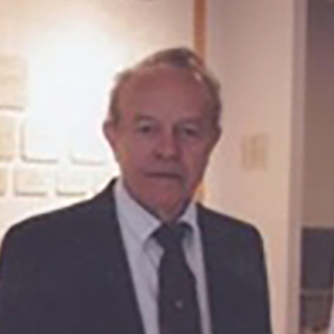
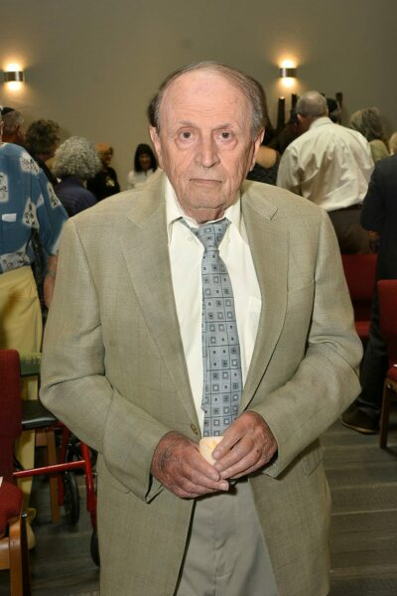
Stephen was the youngest of six siblings, including two married sisters with children. He grew up in a two-room house with a dirt floor. The family lived in one room while his father, a wood turner, used the second room as a workshop.
In 1941, when Germany invaded Poland, the Nazis ordered all Jews to assemble in the marketplace. Stephen, 14, refused to go. He remained home with his grandmother. His parents and a brother were murdered that day.
Stephen, his grandmother, and several siblings remained in the Zambrov ghetto until January 1943, when the Nazis had wagons bring ghetto survivors to cattle trains bound for Auschwitz. Steven, 16, was “selected” to die in the crematorium. He saved himself by sneaking into the younger, able-bodied group that was marched to Birkenau. There his arm was tattooed with number 88647.
His first job was sweeping the barracks. Later, Nazis had him dynamite houses. After Auschwitz was liquidated in 1944, Stephen was sent to Oranienburg, then to Dachau. In late April 1945 Stephen was forced on a death march. On the main highway, Stephen witnessed Germans surrendering. He then saw American soldiers, so he joined them.
Stephen connected with an uncle in Philadelphia. In August 1949 he arrived in America without any money, only three years of grammar school, and speaking little English. He stayed with his uncle and aunt. Stephen, skilled with his hands, became a butcher.
He married Clara Tobin in 1952. They had four children and six grandchildren. In 1987, Stephen and Clara moved to Phoenix. Stephen spoke to various organizations about his Holocaust experiences. Stephen passed away on June 11, 2010.
Stephen Lerman z”l
Born: Sept. 15, 1927
Zambrov, Poland
Phoenix Holocaust Association Arizona Jewish Historical Society
The Feiges family was detained in Niolajew. Subsequently, the family was taken by train to Auschwitz, where Ike had an experience with the infamous “angel of death,” Dr. Josef Mengele. Ike was waiting in Mengele’s office when the doctor decided to go to dinner. All alone, Ike left the office and managed to avoid Mengele from seeing him after that.
While at Auschwitz, Ike survived by blending in at all times. Always hiding, Ike would stay in the back of kitchens, where food was in short supply. Between 1941 and 1945, the majority of those not taken to the gas chambers of Auschwitz eventually succumbed to disease or were shot by the Nazis.
Ike’s father had been a tailor and considered valuable in Auschwitz, which helped Ike’s father and mother survive. When the Russians liberated Auschwitz in January 1945, Ike was just nine years old. He and his parents spent several years in a displaced person (DP) camp and then came to the U.S., when Ike was 15. He went to high school and after graduation he went to the Army Corp of Engineers as a communications specialist. He subsequently went to the Naval Academy, where he became an assistant to an electronics professor (like a graduate assistant). He met his wife Nancy through B’nai Brith in Baltimore.
Ike moved to Phoenix working for the Defense Department as a quality control electronics expert at Motorola. Nancy worked for Motorola in their office. Ike and Nancy have lived in the Phoenix area ever since.
Ike Feiges
Born: June 20, 1935
Czernowitz, Romania
Phoenix Holocaust Association Arizona Jewish Historical Society

Slide 11
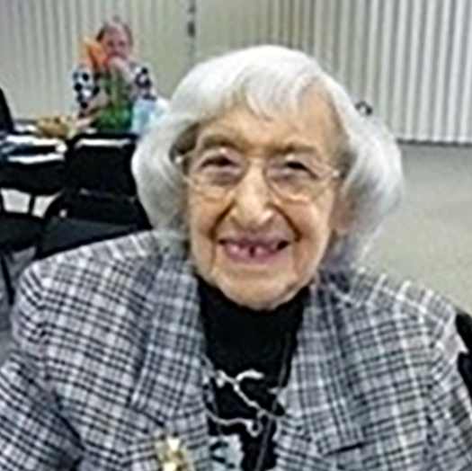
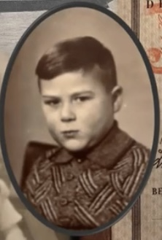
Jeannette was an only child of Marianne and Salomon Marx. Her father had a cattle insurance business, headquartered in Cologne. Prior to Kristallnacht, their synagogue, which had been largely donated by Jeannette’s maternal grandfather, was ransacked and completely destroyed, as was their own home. However, all her father’s WWI decorations, including the Iron Cross award, were left on the wall untouched.
On Jan. 18, 1939, at age 17, Jeannette was put on the Kindertransport to England. In 1941, Jeannette quit her job as dressmaker and joined the ranks of the London Auxiliary Ambulance Service. Having once wanted to be a doctor, she became a medic instead. She learned how to drive an ambulance during blackouts and made runs to the hospital and morgue during air raids. While her work was dangerous (two of the 14 drivers were killed) she was determined to help the world. Besides, she “wanted to get back at Hitler.” Her years of studying French paid off as the Aussies in her unit called her “Frenchy” to avoid saying she was German.
Jeannette’s mother perished in Auschwitz; her father was deceased as well, although Jeannette was never able to ascertain when, where or how he died. In 1946, Jeannette received an affidavit of sponsorship from a cousin in New York and made her way to Washington Heights. She got a room with a German Jewish family, applied for a social security card and found a sewing job. She was introduced to a house painter, Ted Grunfeld, from Hungary and they were married six weeks later. In 1976 they moved to Phoenix, where Jeannette died in 2013.
Jeanette Grunfeld z”l
Born: June 4, 1921
Cologne, Germany
Phoenix Holocaust Association Arizona Jewish Historical Society
Peter’s father was a successful lawyer in Germany, and his family members were proud members of the German community. However, with Hitler’s rise to power his parents saw what was coming, and Peter’s father prepared for the time when he could not practice law by becoming a typewriter mechanic. The family emigrated to Holland in 1939, and from there to New York and then to Massachusetts, where they settled. Peter’s family was able to get American passports because a cousin in Kansas City was a physician who had helped treat Harry Truman (before he became president).
Peter points out that his family name reflects much of Jewish history. They were originally from Spain, where the family name was De Silva. When the Inquisition came to Spain they moved to Portugal, and when the Inquisition reached Portugal they moved to Amsterdam, and then to Germany. Peter emphasizes that borders and names were fluid in those days.
Only a few short years after immigrating to the United States, Peter’s father was able to get his license to practice law, and among other things helped many German Jews to get reparations from Germany. He enlisted Peter in the effort to document why reparations should be granted. Although some German doctors said that reparations were not necessary, Peter did research and documented Concentration Camp Syndrome, a post-traumatic stress disorder caused by time in the camps. Symptoms include depression, anxiety, avoidance, and hyper-vigilance, among other things.
Peter lives in Scottsdale and frequently speaks about his family’s experience in the Holocaust.
Peter van der Walde
Born: July 11, 1933
Essen, Germany
Phoenix Holocaust Association Arizona Jewish Historical Society

Slide 12
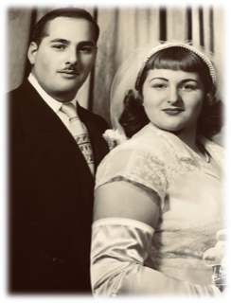
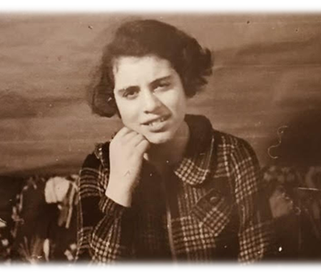
Birgit was born to Oskar and Toni Blumenthal in Hochstaetten. She was the youngest of two daughters and enjoyed a very comfortable life with her parents, older sister (Inge) and grandparents (Bernhard and Julie Wolf). The family were the largest cattle brokers in Germany which supported them very well. The Nazis took control of their business but denied them visas to leave the country. Birgit vividly remembers the fear and confusion she felt when neighbors surrounded their home, threw rocks and screamed “dirty Jews” at them in October 1938.
Soon after, the events of Kristallnacht convinced the family to send their daughters to safety on a Kindertransport to Sweden. Birgit was 7 years old and spent the next 1.5 years in Sweden before she was taken to the port to meet the ship that her parents and grandparents were on. Thus began the voyage to the United States in March 1940. She proudly recalled that she celebrated her 9th birthday in the US.
What she always remembered was the humiliation of being 9 years old in a kindergarten class to learn English. Her sister, age 13 was there also. As they grasped the English language, they were moved to higher grades. Birgit was very artistic and went on to attend the Chicago Art Institute and gained employment with Marshall Fields’ department store as an advertising illustrator. She married, moved to South Bend, IN and had 3 children. Birgit and her husband spent the winter months in Tempe, AZ near her adult children and grandchildren until she passed away in May 2017.
Birgit Blumenthal Metzger z”l
Born: April 7, 1931
Hochstaetten, Germany
Phoenix Holocaust Association Arizona Jewish Historical Society
Inge was born to Oskar and Toni Blumenthal in Hochstaetten. She was the first born and enjoyed a very comfortable life living with her parents, younger sister (Birgit) and grandparents. The family were the largest cattle brokers in Germany which supported them very well. They sent Inge to a private school in a neighboring town.
One day, the teacher was showing the students posters of what a Jew looked like with emphasis on the large nose. Inge, who was very bright and not shy, spoke up asking about ‘Frau Schmidt who had a huge nose and was not Jewish’….in fact, she was the mayor’s wife. The teacher became angry and told Inge to take her belongings and leave school immediately. Confused but complying with his orders, she left what would be the last day of her education in Germany. The teacher released the rest of the class with instructions to chase and taunt Inge. Her father came to bring Inge home.
The Nazi party wanted to control the main food source by forcing the Blumenthal/Wolf men to lose control of their business. Visas to leave Germany were not easily obtained. The events of Kristallnacht convinced the family to send their daughters to safety on a Kindertransport to Sweden. Inge was 11 years old and spent the next 1.5 years in Sweden before she was taken to the port to meet the ship that her parents and grandparents were on. Thus began the voyage to the United States in March 1940.
Inge graduated from Indiana University and began a 45-year career as an educator. After retirement, she moved to Tempe, AZ where she lived near family until her death in Nov. 2017.
Inge Blumenthal Bailin z”l
Born: October 3, 1926
Hochstaetten, Germany
Phoenix Holocaust Association Arizona Jewish Historical Society

Slide 13
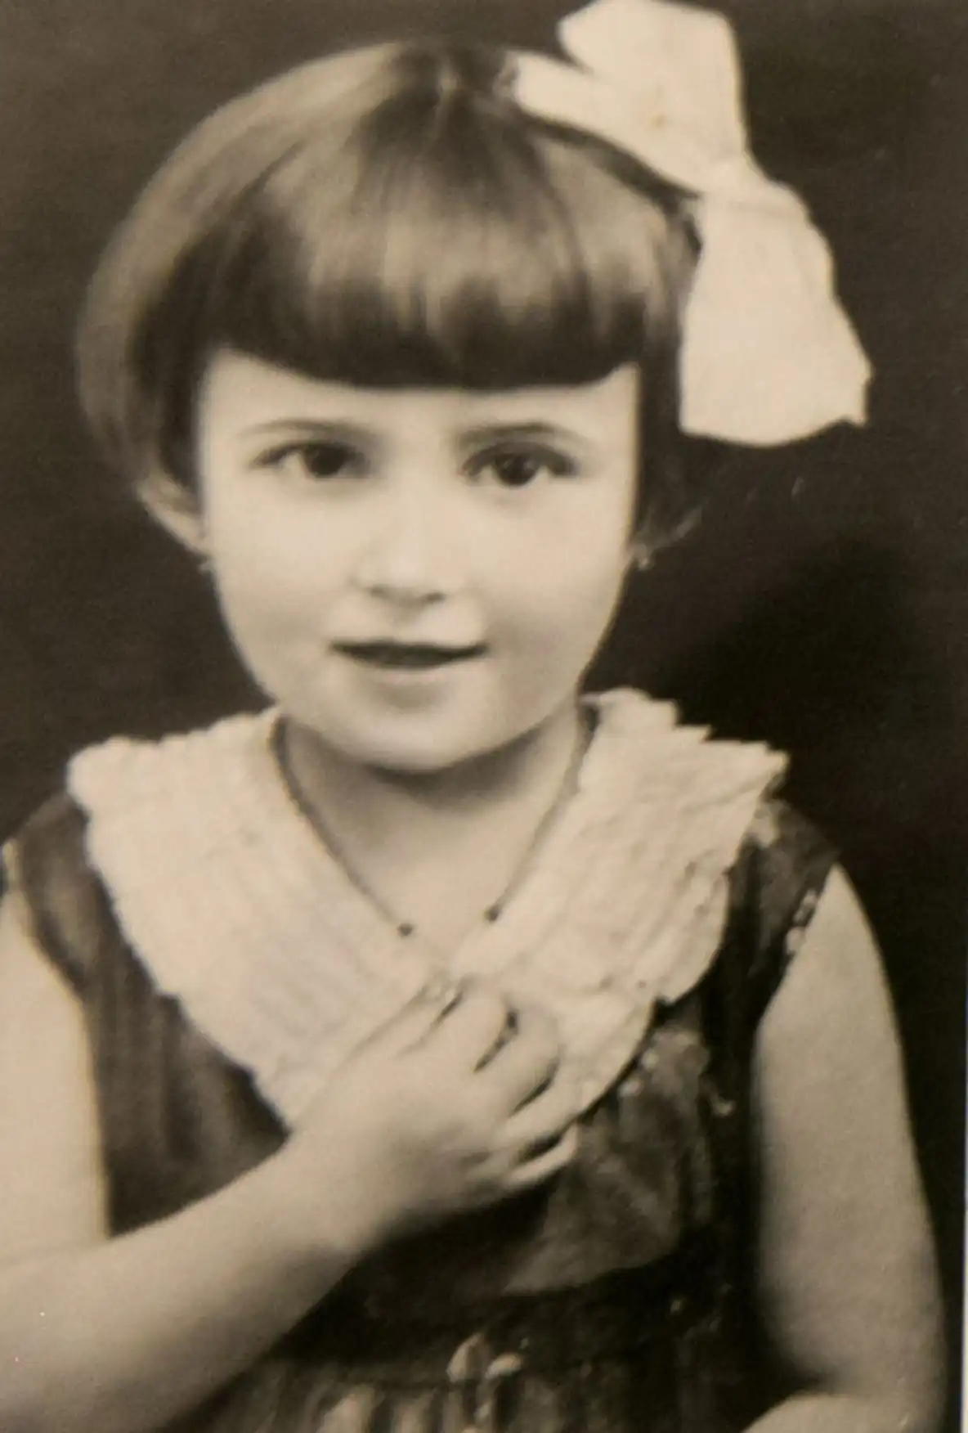
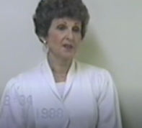
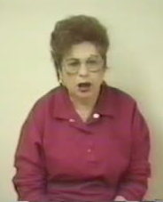
Magda was born in 1928 to Shari and Solomon Weisberger. She had two younger sisters, Lilian and Veronica. Their parents owned a grocery store and kosher butcher in a small town. In 1939 Hungary invaded. Immediately, draconian laws limiting the Jews from owning businesses and going to public school were put into place. The Jews were forced to wear yellow stars. Magda’s father was sent to a labor camp, where conditions were brutal. Magda’s mother became the sole provider for the family.
In 1944, German SS troops were sent to Czechoslovakia. Hungarian police rounded up every Jewish family. Between seven and 10,000 Jews were rounded up and forced into a small synagogue. From there they were marched to another town and forced into the ghetto with other Jews from around the country. Magda, her mother, two sisters, aunt and uncle and his family had to share one room. Food was scarce. Several weeks later, the Jews were herded onto a freight train. They traveled for two days and nights with no water or food before arriving at Auschwitz. At Auschwitz, Magda’s younger sisters and grandmother were sent to the crematorium. Magda and her mother were shaved and sent to the barracks. Conditions were horrific. The inmates were given one slice of bread and a watery soup once a day. From Auschwitz, Magda and her mother were sent to a labor camp, where Magda worked in a munitions factory.
At the end of January 1945, Magda was liberated by the Russians. When they returned to their hometown, they learned that Magda’s father had died from typhoid fever in the labor camp, making Magda and her mother the sole survivors of their immediate family. Magda and her mother emigrated to the U.S. in July 1946 and lived in Chicago before moving to Arizona. Magda died in 2019.
Magda Weisberger Willinger z ”l
Born: June 1, 1928
Czechoslovakia
Phoenix Holocaust Association Arizona Jewish Historical Society
Anna was born Hasia Luhenberg in Bialystok. Her parents, Yona, and Rashia, had four children: Leah, Hasia, Shprinza and Mayer. Anna was 14 when the Nazis arrived at Bialystok. One of the first things the Germans did was to round up 2,000 Jews and force them into the main synagogue. They burned the synagogue down with all the Jews inside. The synagogue fire went out of control and half of Bialystok burned to the ground.
Anna and her family were forced into the ghetto along with 60,000 Jews. The cold and hunger were horrible as were the living conditions. Typhus spread throughout the ghetto. As a warning to all the Jews of the ghetto, the Germans would hang people who they felt did not obey them.
In the ghetto, Anna worked sewing parts for German uniforms. Her payment was one loaf of bread, which she got once a week.
In August 1943 the Germans liquidated the ghetto. Anna got separated from the rest of her family and never saw them again. She was transported to Majdanek concentration camp. When she arrived, she remembered, she smelled the burning of human flesh. From Majdanek, Anna was transported to another camp, where she got typhus, and then to Auschwitz, where she stayed for more than five months. From Auschwitz, Anna was transported to another camp before being shipped to Theresienstadt. Each transport required long days in cattle cars with no food or water. Anna was liberated from Theresienstadt on May 9, 1945, by the Soviet army. She and a cousin were the sole survivors of their large families. Anna died in Phoenix on April 12, 2008.
Anna Koenig z”l
Born: 1926
Bialystok, Poland
Phoenix Holocaust Association Arizona Jewish Historical Society

Slide 14
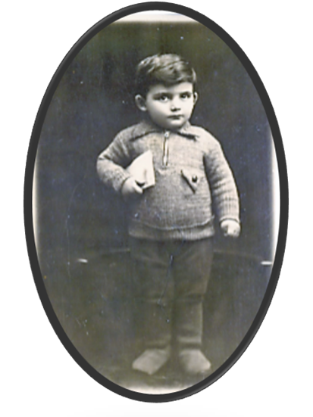
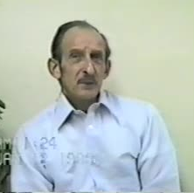
Sam Holckiener was born in Warsaw in 1929. War broke out in 1939, and by 1942, most of Sam’s family had been deported. Sam was the only one of his family to survive the war.
By 1943, after surviving the horrors of the Warsaw Ghetto and being part of the Warsaw Ghetto uprising, he and his father were deported to Majdanek concentration camp, outside of Lublin in Poland.
In Majdanek, the gutsy 12-year-old boy avoided death by standing on tiptoe and declaring he was 16; Sam was directed to the work line, rather than with those slated for death. A month later he was sent to a work camp, Skarzysko-Kamienna, in Poland, where he survived typhus; his father died there of starvation and wounds.
In the spring of 1944, he avoided death again by boldly ignoring his name when it was called to line up for a new “assignment.” Those who stepped forward were later shot. From November 1944-March 1945, he was in another work camp for Jews and non-Jews. When the Germans evacuated the camp as the Russians came closer, Sam had another escape from sure death when he and the Jews were sent on a death march to Theresienstadt; the non-Jews were shot.
After the Russians liberated Theresienstadt in May 1945, Sam spent several months in a rehabilitation center in England before he made his way to the United States, where he joined the U.S. Air Force, became a naturalized U.S. citizen, completed college, and became a CPA. He married and had two sons. Sam died in November 2008 in Scottsdale, Arizona.
Sam Hilton z”l
Born: September 23, 1929
Warsaw, Poland
Phoenix Holocaust Association Arizona Jewish Historical Society
Carl was 13 when Jewish students in Poland were banned from going to school. He had to wear a Jewish star and remembered constant bullying. His father was a tailor, and Carl was the youngest of four siblings. The family had been in the Lodz ghetto from 1941-1944. Carl worked in the leather factory. His father died in the ghetto from starvation. The ghetto was liquidated in 1944 and the railcars took them to Auschwitz-Birkenau. The family was immediately separated. He remembered his mother holding hands with his two sisters. That was the moment he knew he was alone. His mother and two sisters were murdered in the gas chambers. Carl was immediately tattooed with number B847.
Carl had various jobs, being sent to four concentration camps—Lieberose, Sachenhausen, Mauthausen, and Gunskirchen—and on three death marches.
On May 7, 1945, Carl, who was 19 at the time and only 55 pounds, was liberated by U.S. armed services in Austria and spent months in the hospital.
Carl met Ruth in a displaced persons camp and learned his brother, sister-in-law and their baby did not survive. After immigrating to the United States, Carl and Ruth lived in Chicago for 33 years and had a son and daughter.
Upon moving to Phoenix, Carl was instrumental in forming the Phoenix Holocaust Survivors’ Association, serving as president. He spent his time, energy and experiences speaking to schools and groups bearing witness to the Holocaust. He always repeated, “I am one of the lucky ones.” Carl died in 2014.
Carl Ofisher z”l
Born: January 5, 1926
Lodz, Poland
Phoenix Holocaust Association Arizona Jewish Historical Society

Slide 15
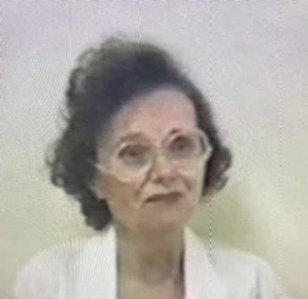
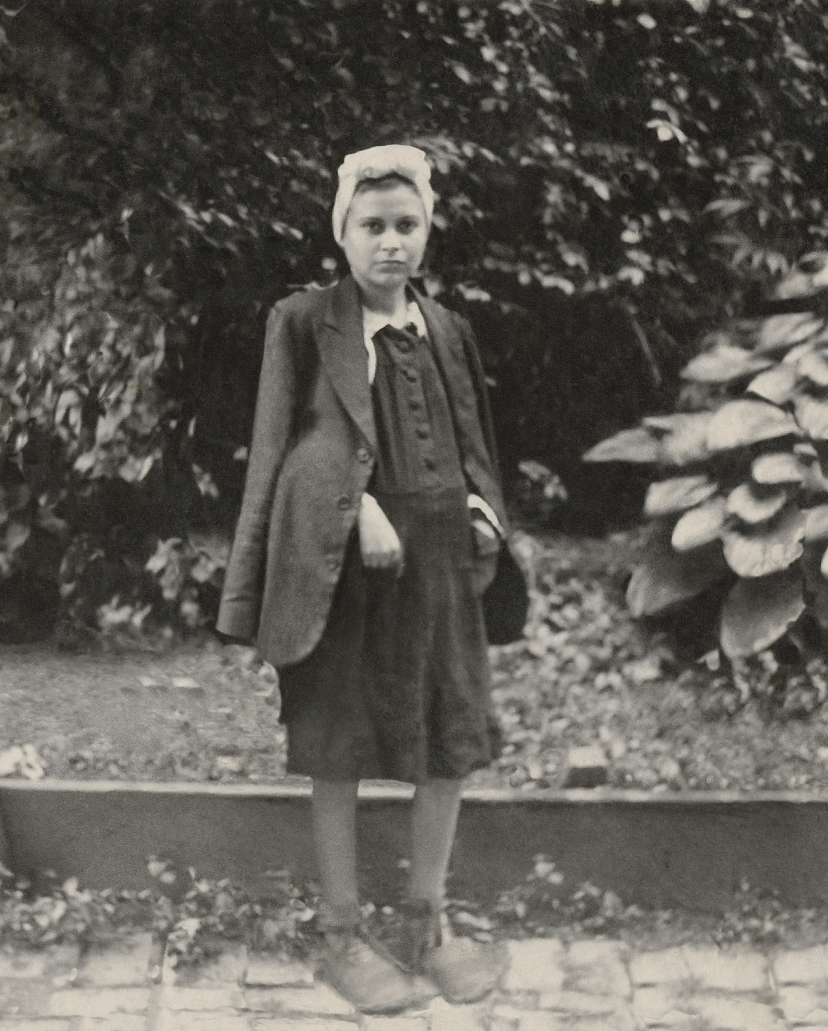
Anna lived with her father, stepmother, one biological sister and three stepsiblings on a farm. She attended school through sixth grade, at which time she was made to wear a yellow star on her dress and could no longer safely attend school. Of their family, only she and her biological sister survived.
On being deported to Auschwitz, Anna and her family were loaded onto a train cattle car and traveled for three days without food. Anna was 15 years old when she arrived at Auschwitz. Every morning in Auschwitz the people in the barracks had to line up to be counted. Each day women would be removed from the lines, never to be seen again. In order to look healthy and not to be taken, Anna’s sister would tell her to pinch her cheeks to make them appear a healthy color. Six months later, she and her sister were forced on a death march to Bergen-Belsen. Anna was liberated in 1945.
She immigrated to the United States in 1949. Anna eventually moved to Phoenix in 1961 and lived here until her death in 2019.
Anna Spitz z”l
Born: 1929
Czechoslovakia
Phoenix Holocaust Association Arizona Jewish Historical Society
After being forcibly moved to the Jewish ghetto, Helen and her entire extended family were transported to Auschwitz in 1943. She was 15 ½. Helen was the only one of her family to survive the Holocaust.
In July 1944, Helen was among the first contingent of Jews transported from Auschwitz to the Stutthof Concentration Camp, near Danzig, Poland. Lice were rampant infecting many prisoners with typhus. One day, when inmates were being separated to go to a work camp, mustering real chutzpah, she sneaked into the work camp line. Returning to Stutthof 4-5 weeks later, most of the remaining residents were dead, primarily from disease; bodies were piled like garbage throughout the camp. The remaining 1000 inmates were marched out of the camp, going from village to village. Eventually left in a barn with no food or water, the 30 who survived were liberated by the Russians. She was 16 and very ill.
With the help of the Red Cross and by bravely sneaking onto a freight train to Prague, Helen managed to get to a sanatorium for the treatment of tuberculosis (TB) and later to Switzerland when the TB settled in her back. With financial help of Jewish organizations in Switzerland and America, she spent four years there recovering.
In the early 1950s, Helen immigrated to Canada and married; she and her husband relocated to the Detroit area and had one son. When she and her husband divorced, she and her son moved to Phoenix where she had a successful business for 15 years. Helen was an active speaker on the Holocaust and died in 2016.
Helen Ackerman Handler z”l
Born: September 18, 1928
Munkacs, Czechoslovakia (formerly Hungary)
Phoenix Holocaust Association Arizona Jewish Historical Society

Slide 16
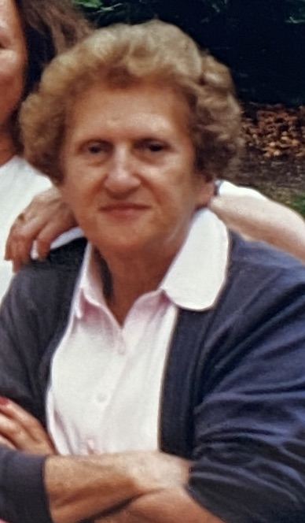
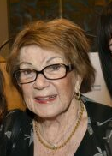
Genia Nordon had two older sisters and an older brother. Her orthodox Jewish family moved to Sosnowiec, Poland after she was born. She lived a pleasant life in Sosnowiec with many friends and activities. In 1939 she finished her first year of high school. The Nazis invaded Poland on September 1, 1939 and normal life was suspended.
The Nordons were soon evicted from their apartment into a less desirable one. Two of her siblings were sent to forced labor camps around 1941. In 1942, the remaining family was forced to move into a more squalid ghetto. Jean hid her yellow star and bartered for food to supplement the rations for the family. Late in 1942, Jean was seized by soldiers and taken to a transit camp in the city. Then, she was sent to another transit camp, Gogolin. In 1943, she was transferred to Gleiwitz, a slave labor sub-camp of Auschwitz. She tried to escape by jumping from a moving train in January 1945. For this transgression, she went through six prisons and wound up in the prison at Terezin. She was liberated there in May 1945.
Of a large extended family, just Jean and one sister survived. Eventually the sisters made their way to a displaced persons camp in Germany. She met her husband Charles there and with a new baby, they were finally able to immigrate to New York in 1950. She moved to Scottsdale in 1998. She passed away in 2012 leaving two children, 6 grandchildren and now 10 great-grandchildren.
Jean (Genia) Flaster z”l
Born: September 5, 1924
Lodz, Poland
Phoenix Holocaust Association Arizona Jewish Historical Society
Bluma was one of six children – three boys and three girls - born to Rose and Moris Bojman. Moris was a successful cattle buyer and ran his own butcher shop.
The three girls were leading typical schoolgirl lives when in 1939, Poland was invaded by Germany. Soon after, anti-Jewish decrees were enacted and escalating to violence. The Bojman family was forcibly moved into a prison-like ghetto. The family was split up. Most of Bluma’s loved ones were murdered in Treblinka. Bluma’s father, sister Mania, and brother Aaron were sent to Concentration Camp Wolanow where Moris suffered from typhoid. Bluma, age 10, snuck in to help her father and was thrown into a crude shack called “death house.” She was saved by her cousin, who had earned special privileges due to his tailoring skills. Mania and Bluma survived by becoming scavengers for scraps of food, They escaped into the woods but the following morning found a carnage of gunfire had killed hundreds of prisoners including their brother Aaron. Bluma’s surviving family at Wolanow were shipped to Auschwitz. Moris was later gassed at Buchenwald. At Auschwitz, the girls were forced into the infamous Dr. Josef Mengele’s selection line, where he decided who to murder and who to use for experimentation or forced labor. Bluma and her sisters somehow survived. They were liberated in 1945.
Bluma, after time in a displaced persons’ camp, emigrated to the US, settled in Omaha, and eventually Phoenix. She found business success, reared healthy children, and became a doting grandparent. Bluma died in 2021 at the age of 91.
Bluma Bojman Polonski z”l
Born: March 10, 1930
Wolanow, Poland
Phoenix Holocaust Association Arizona Jewish Historical Society

Slide 17
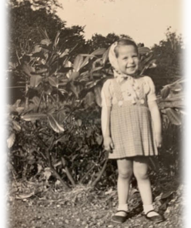
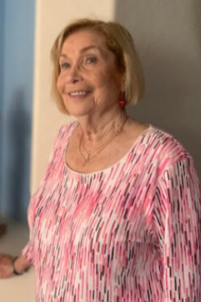
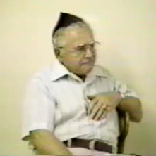
Betty Levensonas and her family lived in Orleans, France until Betty was five years old when her parents moved to Paris where her father opened a clothing store.
Betty recalls explosions in the area when the family would have to seek shelter in the basement of their home while wearing gas masks. While fleeing Paris, she remembers hiding under the seats of the train and covering her ears so she wouldn’t hear the bombing.
Betty’s parents fled to a small French village called Velles. Only two people there knew that her family was Jewish - the mayor and a remarkably strong-willed woman, Julie Couillard. Julie was a single Christian woman with a wooden leg. When Julie would hear that the SS were in the neighborhood, she would tell Betty’s father so that he could run to hide in the fields. If the Nazis entered her home, she would tell them they were all family. She literally saved their lives – even though she did not know anything about them or their backgrounds.
While in Velles, Betty went to school and regularly attended a Catholic church where she prayed to baby Jesus and a cross near the corner of her bed. Around 1945 her parents invited a Jewish American soldier who was stationed nearby, to eat dinner with them. The soldier asked Betty if she knew she was Jewish and Betty replied, “No, I am Christian,” believing she was. Following the war, Betty’s father explained everything to her. Betty was confused for a long time which later led her to study many different religions.
Betie emphasizes the importance of fighting hatred of all kinds, not only of Jews, but of other people as well. Betie now lives in the west valley of greater Phoenix.
Betie (Betty) Newton
Born: April 22, 1935
Orleans, France
Phoenix Holocaust Association Arizona Jewish Historical Society
Solomon’s parents raised him and his three brothers in a conservative Jewish home. After high school, Solomon studied agriculture.
As the war approached, antisemitism increased, and the Germans ordered the Polish people to boycott Jewish businesses. His parents’ home was destroyed by German bombing at the start of the war. Shortly thereafter, all Jews were forced to live in a ghetto in Warsaw. Solomon met and married his wife, Blanka, in the ghetto. In 1942, Solomon was permitted to travel for business to visit metal manufacturers because the Germans needed metal for the war. While away, his parents were deported and exterminated at Treblinka concentration camp.
Soon after, the Germans sent mostly young Jews, including Solomon, to forced labor camps. Solomon worked at two camps shoveling coal and then making weapons for the Nazis. The soup they ate was made from horses executed by the Nazis. There was a daily headcount to ensure no one escaped. The Nazis threatened that if anyone escaped, seven Jews would be shot.
In 1945, Solomon was sent to Buchenwald concentration camp for a few months before the camp was liberated. After the war, he reunited with his wife who had lived as a Christian during the war.
The couple lived in displaced person camps in Germany before immigrating to the U.S. in 1949, eventually settling in California. Solomon started a chicken ranch utilizing his agriculture background and grew it to 20,000 chickens. In 1981, they moved to Arizona to be near their son. Solomon served as president of the Phoenix Holocaust Survivors’ Association. He died 2001 at the age of 98.
Solomon Cukier z”l
Born: 1903
Warsaw, Poland
Phoenix Holocaust Association Arizona Jewish Historical Society

Slide 18
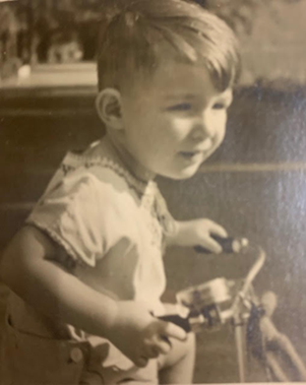
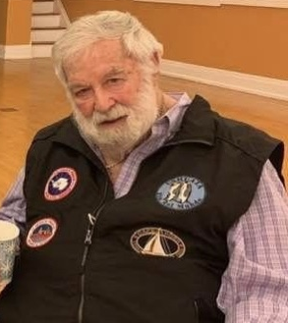
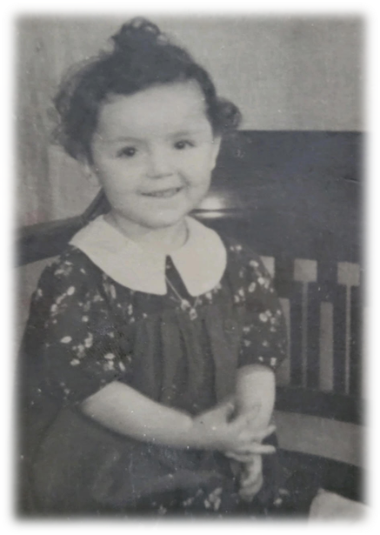
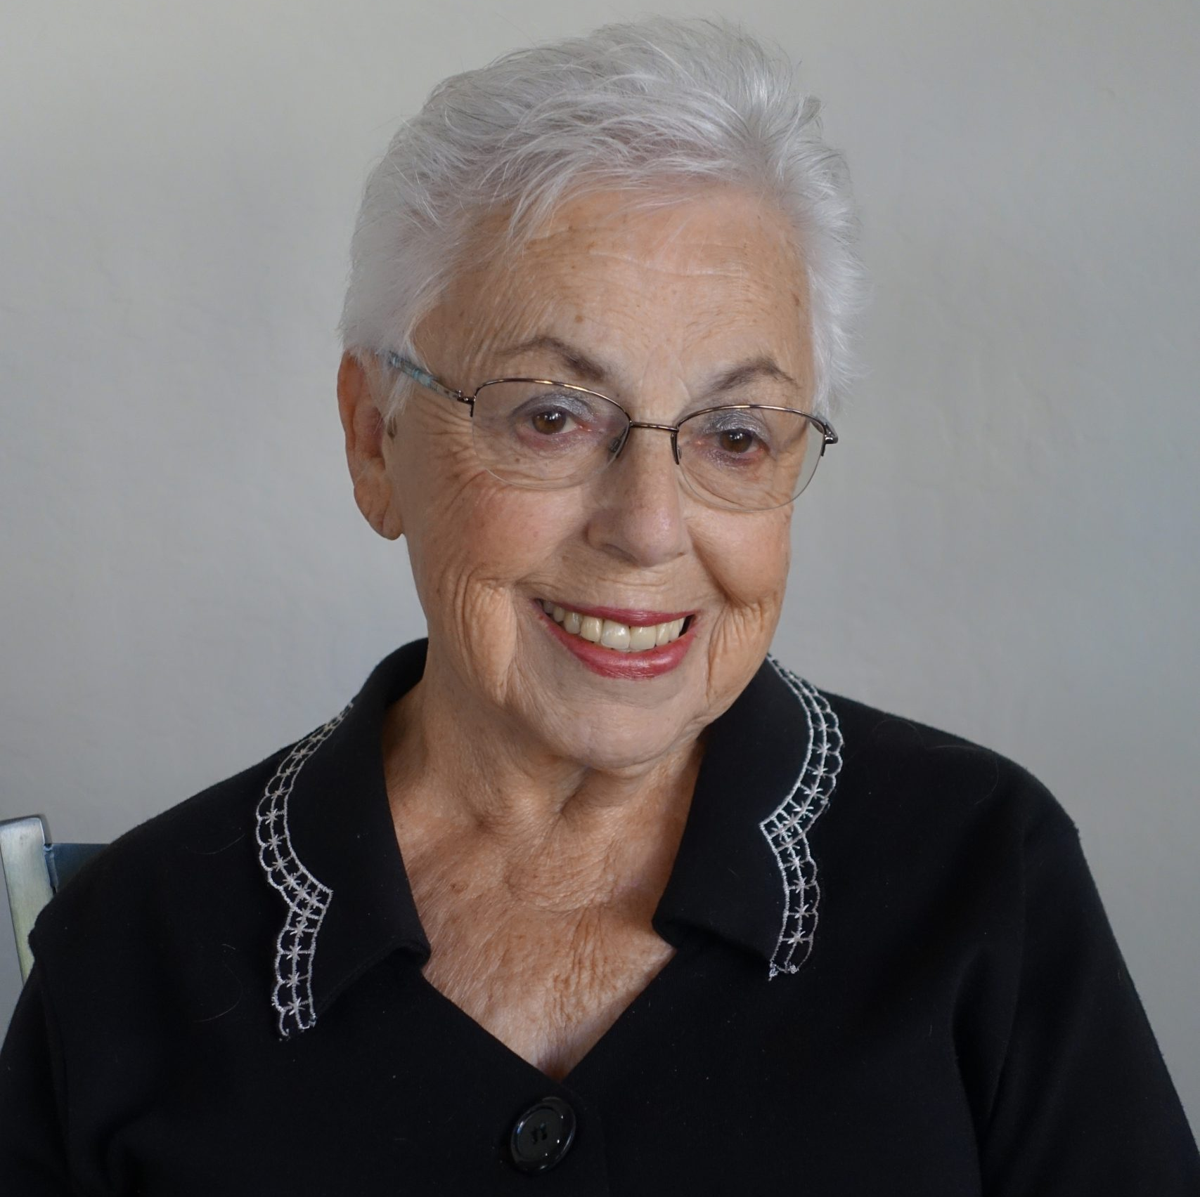
Werner’s family left his birthplace in Germany in 1939, shortly after Kristallnacht. His
mother was an orthodontist who practiced in Berlin for 20 years. She died shortly after the family arrived in the U.S. when Werner was only seven. Werner’s father was a lawyer.
Werner returned to Germany in 1949, as a member of the U.S. military. After he first
worked as an auto mechanic and then as an interpreter, the Air Force recognized his
fluency in German and trained him as an intelligence officer. He was assigned to
interview German officers who had been prisoners of war in Russia. This was the time of the Cold War, and the U.S. felt war with Russia was imminent. The German POWs had helped to rebuild Russian airfields and railway lines after the war, and therefore had information that the U.S. military thought was essential. Werner’s job was to get this information from the former POWs.
While in Germany, Werner met his future wife, Martha. He and Martha have been
married for 67 years. They live in Gold Canyon, Arizona.
Werner is a man of many talents and has worked as a development officer for the
Unitarian Universalist Association, has lectured on cruise ships, and has written a
memoir, two novels, and continues to write poetry.
When asked why he is so active in the Phoenix Holocaust Association, Werner talked
about his stepmother who was part of an exchange of 75 Jewish people from
Theresienstadt concentration camp for 75 German prisoners of war. She brought her
yellow star to the U.S. with her, and the stories she told made a great impression on
Werner. Werner frequently speaks to groups about the Holocaust.
Werner Salinger
Born: April 5, 1932
Berlin, Germany
Phoenix Holocaust Association Arizona Jewish Historical Society
In Marge’s earliest memories, she was living with her mother and grandparents in one room, and they were starving. She has no early memories of her father who had been sent to a slave labor camp. In 1942, the Nazis captured her, her mother, uncle, and grandparents and shipped them to Theresienstadt. They travelled for 2-3 days by train standing in cow dung up to their ankles. When they arrived at the camp, they were hosed down, but it was winter, and their clothes froze to their bodies.
In June 1944, the International Red Cross came to tour Theresienstadt. The worst parts of the camp were hidden, and prisoners were given blankets and other items of comfort in a fake display of their good treatment at the hands of the Nazis. As soon as the Red Cross left, everything was taken back. The conditions were terrible; the barracks were overrun with rats and many people were bitten and died of rabies. Water was scarce. One day, her one friend drank water she found, despite Marge’s warnings that the water was toxic, and her friend died two days later.
Theresienstadt was liberated in May 1945 by the Russians. Marge was eight years old. Those terrible years robbed her of her childhood. Following liberation, she and her mother were sent to the Deggendorf Displaced Persons Camp in Germany, and then to England where, after an eight-year separation, they were reunited with her father. The family subsequently immigrated to the US.
Marge married and with her husband and daughter settled in Phoenix where they owned and operated the Munch A Bagel Deli and Restaurant for many years.
Marge (Margit Zsupnyik) Rich
Born: December 13, 1937
Vienna, Austria
Phoenix Holocaust Association Arizona Jewish Historical Society

Slide 19
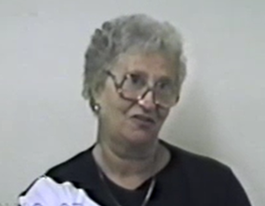
Irma Wertheim lived with her parents, Hedwig and Isaac and her older sister, Lotte in Falkenberg. Her father served in the military as First Lieutenant. He returned to civilian life where he bought and sold show horses. Irma and Lotte attended boarding school at Bad-Nauheim, not far from home.
Irma was 14 years old when she left Germany on The Kindertransport. She saw her parents and Lotte who was 16 for the last time at the railroad station in June 1939. She arrived in England speaking little English. She lived with a Jewish family with a young son for eight years in Birmingham. After some high school education, Irma worked for the fire department as one who notified them where fires from the bombings of English cities occurred.
After the war, Irma received a letter from an uncle convincing her to join family in New York. She bid farewell to her English family and sailed into New York harbor. She looked at the Statue of Liberty in August 1946 and knew the USA was to be her true new country. She received a message from the International Red Cross that her parents and sister had been victims of the Holocaust. Irma was now an orphan.
Irma met William Oppenheim in NYC. She flew to El Paso, Texas, married Bill in 1947 and raised four children in Texas. Her husband along with his brother operated a business called House of Oppenheim in Juarez, Mexico.
Irma moved to Scottsdale, AZ February 2010 to be with three of her four children. She died in 2017.
Irma Wertheim Oppenheim z“l
Born: September 22,1924
Falkenberg, Kassel, Germany
Phoenix Holocaust Association Arizona Jewish Historical Society
When the war started in September 1939, Anna was scheduled to participate in the Olympics in swimming and gymnastics, but Hitler ruined that for her. She was one of four children and attended local public school and a seamstress vocational school. Her parents were Manach and Meir Davidovic. Her siblings included a brother (Herschel), and two sisters (Esther and Libby). Anna’s father was president of the local butcher’s union.
Upon the invasion, only she and her father were sent to the ghetto in Sosnowiec, while her mother and sisters were sent to Auschwitz never to be seen again. Her brother was shot trying to escape the ghetto. With her father’s encouragement, she walked 800 km to Vilna to since it was under Russian control. Once Germany occupied Vilna, she returned to the ghetto at Sosnowiec. Shortly after she was arrested and sent to a concentration camp. Her father hid in a bunker but was executed by Nazis eight days before the war ended. Due to her machining skills, she received better food in the camps. Before this camp, she was at Blechhammer work camp where one of the barrack chiefs, Carl Demerer, treated her well.
After the war, she traveled to Heidelberg, Germany where she met and married in 1946 the brother of a previous boyfriend. Her husband had survived Auschwitz. Due to his help of the Allies in finding Nazis, her husband took over operation of a shoe manufacturer. Their daughter was born in Heidelberg, but they left in 1949; her son was born in Chicago. Eventually, they moved to Phoenix to improve her husband’s health.
Anna Davidovic Been z”l
Born: August 2, 1921
Sosnowiec, Poland
Phoenix Holocaust Association Arizona Jewish Historical Society

Slide 20
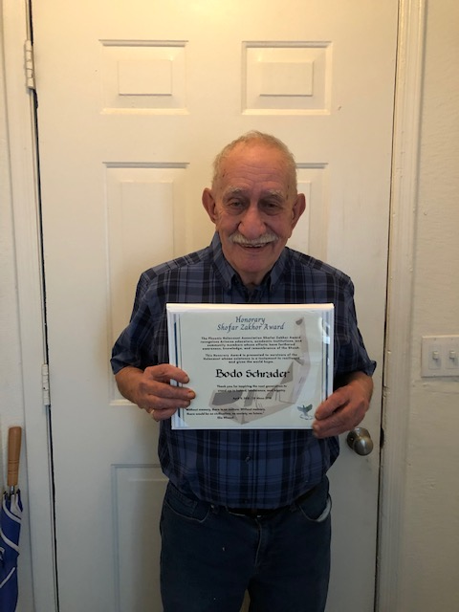
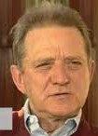
Bodo says he should not have survived. His mother was arrested in May 1942 and sent to Auschwitz where she died before Bodo was a year old. Bodo was sent to a foster home for infants. His father, a Christian, was conscripted into the German (Nazi) army. His mother, a Jew but Christian convert, was arrested for not obtaining a Jewish ID card. When his father refused to get a divorce because of her Jewish background, he was dishonorably discharged from the army and sent to a labor camp.
By the summer of 1943, Bodo, now 4 years old, was sent to Theresienstadt alone since his father was in a labor camp and could not come for him. An elderly Jewish woman in Theresienstadt began caring for him when she found him naked and crying in the camp. She stayed with him after the camp was liberated in May 1945, but because of continuing antisemitism in Germany, she helped him get adopted to a Jewish American family. In 1949, he came to his adopted family in New Hampshire where he remained for many years before moving to Phoenix.
Bodo’s strongest memory from the camp was when a little friend told him he wouldn’t be able to play the next day because he had to take a shower. The boy never returned. When that happened to another boy, Bodo learned that ‘taking a shower’ was a scarry thing, a fear that returns to this day when he showers.
Bodo learned many years later that his grandfather and father both survived the war but were unable to locate Bodo, although they tried. He never saw them or his four sisters again. Bodo lives in the east valley and speaks to school groups.
Bodo Schrader
Born: November 11, 1941
Magdeburg, Germany
Phoenix Holocaust Association Arizona Jewish Historical Society
Chaim and Raizel Altman were a religious, middle-class family, with three older daughters and son, Hersch. After World War II began, German Jewish refugees, who immigrated to Brzezany, spoke of atrocities against Jews, but people believed these were exaggerations.
Hersch was 10 when the Germans, in 1941, took his father and other Jewish men to a local jail and subsequently, executed in the woods.
In 1942, while travelling to hide in a Christian friend’s home, the Gestapo caught Hersch and the youngest of his sisters, Shancia. His sister blocked the soldiers’ view, while Hersch escaped, reuniting with his family. However, Shancia, who insisted Hersch survive in his father’s absence, perished.
A Nazi raid of the ghetto was predicted in the winter of 1942-1943, so his mother paid a farmer to hide them in his barn. Thousands perished in that raid. His family split up for the best chance of survival. Hersch and his mother sneaked back into the ghetto. They waited the next day for his two sisters, but the Nazis had found and shot the girls at the farm.
At times, Hersch hid in nearby forests and escaped multiple times, but on one occasion, his mother and others were apprehended and summarily killed. Near the end of the war, Hersch’s cousins arranged for a Gentile Polish family to hide Hersch in their attic.
Hersch immigrated after the war to Boston and later moved to Arizona. Hersch attended Tufts Dental school and is the author of On the Fields of Loneliness, a book that recounts his harrowing losses and miraculous survival.
Hersch Altman z”l
Born: 1931
Brzezany, Poland (now Ukraine)
Phoenix Holocaust Association Arizona Jewish Historical Society

Slide 21
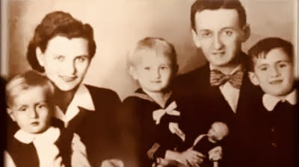

Alex (Sandor) Dancziger was born on April 8,1937 in Miskolc, Hungary. His parents saw the warning signs and the rise of anti-Semitism following the Nuremberg laws. Alex was literally saved by his mother in the nick of time, grabbing Alex and fleeing through the back door of their home as Nazis approached the front porch. In 1944, with quick decision making and wit, Alex’s mom evaded capture by hiding Alex and his siblings at his Catholic grandparents’ home in the nearby small town of Izsofalva. Alex’s father ended up in a slave labor camp where he was liberated in the spring of 1945, and then spent time at a local hospital. Following liberation, Alex’s parents stayed in Hungary, and settled in his Dad’s hometown of Sarospatak, under the Soviet sphere during the Cold War. His parents finally escaped the communist regime and immigrated to Canada on the USS General Ballou in 1949.
Alex later went on to raise a family of his own and became an entrepreneur. Alex is now retired and lives in Fountain Hills, Arizona.
Alex(Sandor) Dancziger
Born: April 8,1937
Miskolc, Hungary
Phoenix Holocaust Association Arizona Jewish Historical Society
Holocaust survivor, Paul Adler was born January 1941. His family was from Gleiwitz, Germany. On Kristallnacht, his father was apprehended in Breslau, Germany and taken to Buchenwald where he spent six weeks before his mother was able to receive papers which came via the Red Cross in Lisbon. The papers came just in time, as Paul’s mother was successful in bribing a Gestapo official to escort her by train to Buchenwald and have Paul’s dad released. They boarded the ship, Watussi which was destined for Mozambique in Africa. Upon arrival they were transported to Swaziland.
Today Paul lives in Mesa, Arizona with his wife Clarise.
Paul Adler
Born: January 1941
Gleiwitz, Germany
Phoenix Holocaust Association Arizona Jewish Historical Society

Slide 22


Abe was born in a Polish shtetl only 30 km from Germany called Shepitz. He lived with his parents, Masha and Yankl, grandfather, and seven siblings. The family was poor and owned a small butcher shop. Abe was the sole survivor of his family.
Due to anti-Semitism in Shepitz, Jews were afraid to go to synagogue on holidays and were harassed and stoned by town people. Abe only went to school until the 7th grade as he had to help in the store.
Shepitz was occupied in early September 1939. The Jews were periodically gathered in a synagogue, and many were shot or sent to concentration camps while the townspeople laughed. Abe eventually escaped to a ghetto in a nearby town. Abe was then sent to a concentration camp and later changed his identity so that he could join his brother in another camp. Later they were sent to Auschwitz, Birkenau where they unloaded clothing from the death train transports for two years. He said every day was hell. In 1944, he and his brother were sent to Dachau claiming to be carpenters and in April 1945 he was taken on a death march with 10,000 others. His brother and 7000 died on the march. Abe was liberated May 8, 1945.
Abe emigrated to the US where he eventually opened a successful meat business. Abe died in Phoenix in 2018.
Abe Morgenstern z”l
Born: 1925
Shepitz, Poland
Phoenix Holocaust Association Arizona Jewish Historical Society
Aaron Bendetson’s father’s name was Tzvi and his mother’s name was Chaya. His father died in 1920 when he was a young boy, and his mother was killed by Germans during the Holocaust. In 1941 he had typus and was in the hospital where he heard rumors about the Germans approaching. He left the hospital and ran away to Russia, where he spent 23 months in the Russian Army fighting in Moscow and Stalingrad. In his oral testimony, Aaron briefly mentions the start of the war, and the role of local Lithuanians who killed Jews under Nazi direction. The details of his experience are very sketchy, but he was imprisoned by the Soviet Army for reasons not clearly stated. He had an accident while running and fighting and lost part of his thumb. He got an infection and had to treat himself as best he could. After spending 23 months in the Russian army, he was arrested for not having the right papers. At one point, he came close to committing suicide while imprisoned.
His brother, who was with the American army, found him in Poland after the war and brought him to the U.S. (through first France and then Belgium), where he started a candy store in New York City. Aaron entered the US through Ellis Island and has two sons who write for television.
Aaron Bendetson z”l
Born: 1909
Merkine, Lithuania
Phoenix Holocaust Association Arizona Jewish Historical Society

Slide 23


Joseph lived with his mother, seven brothers, a sister and his father, a tailor. His father was conscripted to fight for the Russians and was killed in battle in 1916, leaving his mother to raise the children alone. Joseph apprenticed as a
tailor and went to work to support the family. In 1939, he had a girlfriend, Gerda.
1939-1943: Joseph moved to Lvov to find Gerda (her family had gone there.) When the Germans invaded the city, the Jews were moved to ghettos. He was put to work by the German Army collecting papers and bottles. Joseph fled the ghetto to the woods where he lived for 2 ½ months. He returned to Lvov to find Gerda. They left Lvov when the Ukrainian police came looking for him.
1943-1945 They fled to Warsaw, Poland, where he and Gerda purchased false Aryan identity papers. Joseph was picked up by Gestapo officers but talked his designated murderer out of killing him by lying in an open grave while the German soldier fired a shot over him. Gerda became pregnant with their daughter, Barbara, and he supported them through various tailoring jobs. Joseph had his daughter were baptized while pretending to be Christian.
Joseph and Gerda left for Israel in 1950. In 1951, they immigrated to Canada. Their daughter Barbara moved from Canada to Phoenix with her husband and daughters where her parents joined her.
Joseph Dattner z”l
Born: 1907
Austrian-controlled Zywiec, Poland
Phoenix Holocaust Association Arizona Jewish Historical Society
David was born into a middle-class family in Warsaw the youngest of five children. His father owned two successful leather stores. Their home was religious so in addition to public school, David attended religious school. Life was pleasant despite the prevalent anti-Semitism.
When war broke out in Poland in 1939, David’s father told him to leave. That began a journey for the next several years. At one point, David returned to Warsaw, lived in the Warsaw Ghetto and became part of the resistance. When the ghetto was liquidated, he was transported to Treblinka where he worked in a munition factory. He was transferred to Dachau and then to Mittlebaum from where he escaped. On May 1, 1945, American soldiers liberated him.
He met his wife, Rose, in a DP camp in Stuttgart where they married. The couple came to the U.S. in June 1946. He had two sons and a daughter. He worked for eight months in New York in the fur industry and then moved to Denver. In 1958 he started his own fur business and got involved with B’nai Brith, the Masonic Order and the Shriners. He became an emissary for the State of Israel and took many Masons and Shriners there. The Silvers wintered in Phoenix for many years. David died in 2006.
David had lost his entire family in the Holocaust.
David (Zilbershtien) Silver z”l
Born: 1917
Warsaw, Poland
Phoenix Holocaust Association Arizona Jewish Historical Society

Slide 24


Meyer lived with his mother, father, two brothers and grandmother. His father made hats and sold fish. His dad was a Zionist and taught Hebrew school in secret. Meyer went to school until he was 14, then worked in a hardware store.
The war started in 1939. The Germans harassed the Jewish families by chasing and beating them in the street. They took everyone to the synagogue and took their valuables. The Germans chose four of the most beautiful women, made them strip naked, and sexually assaulted them in front of everyone.
The Germans forced them into the Warsaw Ghetto. Meyer did manual labor (shoveling snow, cleaning cars, sweeping streets) for the Jewish Committee. They were beaten often and eventually escaped from the ghetto to a neighboring town and another ghetto. He worked on a farm but came back to check on his parents only to find them weak from typhus and covered in lice. He nursed them back to health. Later, his mother and brothers were shot into a mass grave.
The ghetto was liquated; Meyer and a cousin were sent to Auschwitz. He survived because he laid bricks and traded clothing for food. They were beaten and tortured. In October 1944 when the Russians were near, they were forced on a death march by the Germans. Meyer survived Flossenbürg, Buchenwald, and Theresienstadt camps.
Meyer was liberated in 1945. In a displaced person (DP) camp, Meyer married Sally and had a son. He immigrated to the US with his family in 1950 and lived in Chicago and moved to Scottsdale after retirement.
Meyer Dragon z’l
Born: 1921
Poland
Phoenix Holocaust Association Arizona Jewish Historical Society
Rae lived with her mother and two sisters as her father died when she was young. Her mother owned a shoe store and was a very successful businesswoman. When Rae was 15 years old, she left public school to attend a Zionist school to her mother’s dismay. Rae married in 1941. When the Germans came, Rae and her family tried to leave but the borders were closed.
They moved to Kovno and were put in a ghetto. The Jewish people were made to wear Stars of David and were not allowed to walk on the sidewalk. The heads of three prominent Rabbis were cut off and put in the windows of the synagogue. The Jewish people were put to work cleaning the streets, carrying rocks and doing other menial work. Every so often, the Germans would come into the ghetto and select who was to be killed. Rae became pregnant while in the ghetto and chose to have an abortion (without pain medicine or drugs) because the Germans killed pregnant women. Rae and her family survived because her husband dug an underground hiding place for them.
In 1944, they were discovered and sent to Stutthof in Germany. At the camp, the women were separated from the men, and the women were forced to undress. The Germans examined their private parts to make sure they were not hiding gold or valuables. Then they were forced to dig trenches for the German war efforts. If you could not work, you were killed. Rae’s sister was very sick, so Rae did her sister’s work as well as her own.
When the Russians advanced, the Germans retreated. They were liberated and taken to the city of Lodz, Poland. Rae learned her husband was alive and in Berlin. They went to Austria with her sister to a DP camp. They immigrated to the US in 1949 and moved to Chicago.
Rae lost her entire family except for her sister and a few cousins. Rae and her husband Sol had one son and two grandchildren. Rae died in 2007 in Phoenix.
Rae Freisinger z”l
Born: May 2, 1918
Lithuania
Phoenix Holocaust Association Arizona Jewish Historical Society

Slide 25



Sally lived with her mother, father and two younger brothers in the section of Warsaw that would become the Warsaw Ghetto. Her father was a clothing salesman, and her mother was a receptionist. In September 1939, war broke out. Sally’s friend suggested that the two them flee to Russia. Sally convinced her mother to let her go. Her father walked her to the edge of the ghetto and bribed the guard. Sally took off her armband with the Jewish star. This was the last time she saw her family. She was 16 ½ years old.
The friends took a boat to Sandomierz, Poland where Sally found a Polish family willing to take her in. She stayed with the family from June 1941 to Oct 1942. German soldiers raided homes looking for Jewish people. The woman who took her in said it was too dangerous for her to stay and procured a Polish birth certificate for her under the name of Helena Dobroska. Sally then went to the Germans and told them she was a Polish orphan and needed work. They sent her to a farm in Austria. Sally took care of the horses and cows, moved hay and delivered milk. On the farm, food was plentiful. She went to church every Sunday with the neighbors and said prayers and took communion.
In 1945, the Russians liberated them. Sally looked for her family, but she learned none had survived. She went to a DP camp in Landsberg, Germany. She accidently broke her leg. While in the hospital, a mutual friend suggested that Meyer come visit her. A year later they were married, and in 1947 their son was born. They immigrated to the US in 1950 and lived in Chicago. When they retired, they moved to Scottsdale in 1984.
Sally Dragon z”l
Born: 1923
Warsaw, Poland
Phoenix Holocaust Association Arizona Jewish Historical Society
Henry Sontag was one of five children born to Maurycy and Yetty. They moved the family to Vienna during World War I. Life was good for Henry, who attended school until the age 14, however things began to change with manifestations of hate and intolerance permeating society.
1938-1959: Henry and his brother Elie left for Belgium in 1938. Henry worked odd jobs and married Dora who had a son, Henri. Although Henry worked with an underground group, attempts to smuggle his mother and father into Belgium failed. They were later arrested and sent to Buchenwald and neighboring camps. Henry and his brother were transferred to a French prison camp called St. Cypien. Conditions were horrible. Henry survived typhus and managed to escape and return to Belgium. He learned that his wife and Henri were in Switzerland. Henry remained in a detention camp until the war ended in 1945. His brother Elie escaped to the Dominican Republic in 1941. The brothers were reunited in the Dominican Republic. They came to the US in 1959. Henry’s other siblings survived. His parents did not.
1959-1992: Henry and his family moved to Los Angeles, and then Phoenix. He wrote an autobiography and shared his experiences with student audiences throughout Arizona. Henry died in 2019 at the age of 105.
Henry Sontag z”l
Born: March 1914
Lemberg, Austria
Phoenix Holocaust Association Arizona Jewish Historical Society

Slide 26


Harry’s family was originally from Poland and moved to Germany after WWI. In 1932, the Nazis were coming to power in Germany and his family moved to Paris where Harry attended primary and high school. His father was an apprentice furrier in Austria and went into the fur business in France. In 1939 his father moved back to Poland to start a new business and Harry remained in France living with a Russian family.
When Germany invaded France in 1940, Harry’s parents returned and tried to escape to Portugal, but they were stuck in Casablanca for five months. Eventually they made their way to the American Embassy in Lisbon where they obtained visas to the US.
Harry went to night school and obtained his GED and enlisted in the US Army. During his service he was stationed at various US bases and was eventually sent to Europe because of his foreign language skills. Harry went to Buchenwald one day after the camp was liberated. He was shocked by what he saw.
Harry married Ella, a Holocaust survivor in 1951 and they eventually moved to Phoenix, Arizona where he started an upholstery business. Harry had one daughter who lives in Israel and a son who lives in California.
Harry helped co-found the Jewish Free Loan and the Phoenix Holocaust Survivors’ Association. He died in 2013 in Phoenix.
Harry Adler z”l
Born: 1924
Berlin, Germany
Phoenix Holocaust Association Arizona Jewish Historical Society
Joseph’s birth name was Yehuda Hillel; he adopted the name Joseph to match papers that he used to cross borders. He was the first born in his family and had one brother, Abraham Heber Bash. His mother passed away from tuberculosis and his father remarried and had many more children.
At 11, he became an apprentice in his uncle’s store in Budapest. In 1944 at the age of 22, he volunteered for work details to avoid the pogroms. Retreating with his Hungarian overseers before Russian advances, his group of 200-300 prisoners ended up in Austria-Hungary. When the Russians overtook them, only thirteen prisoners remained alive. The Russians freed them on April 4, 1945. After being liberated, he traveled to Budapest, and then on to Bucharest where he was reunited with his family.
His family remained in Bucharest during the war and, through bribes, managed to survive. His brother worked for the resistance, making his way to Palestine and then back to Europe with the Jewish Brigade. After the war, Joseph helped child survivors, who were organized into kibbutzim, prepare to go to Israel. It was at these kibbutzim that he met his wife, Esther. Joseph and his wife went to Israel, escorted by the Haganah. However, the British forced them to go to Cyprus. After a while, he and Esther (now pregnant) made it to Palestine, where he joined the Haganah. Eventually he obtained a US visa. He went on to live in New York where he owned a jewelry shop with his brothers. Joseph and Esther had four children.
Joseph died in 2004 in Phoenix.
Joseph Basch z”l
Born: September 13, 1923
Buchan, Romania
Phoenix Holocaust Association Arizona Jewish Historical Society

Slide 27


Mania was born into a very loving family in Wlodzimierz, Poland. She was the youngest of three daughters and idolized her two older sisters. Her father was a pharmacist with his own business and her mother was a homemaker. A pharmacist in those days was considered on the same level as a doctor so her family was considered very prestigious. They even had a radio in their home which was rare.
When the Nazis invaded Poland, her father’s business was confiscated, and he was forced to work for another pharmacy in a neighboring town. For the first few years her hometown was occupied by the Germans, then the Russians, and then back to the Germans. Mania and her family were forcibly moved to a ghetto where they lived for the rest of the war. Her sisters and parents were murdered in a mass grave. Mania survived as a laborer in the fields and as a knitter in German factories. She knitted numerous woolen items for Nazis’ families.
After the war, Mania with her husband, Joseph, and his brother, Moishe, moved to Montreal, Canada to start a new life. Years later, she moved to Scottsdale, Arizona to be near one of her daughters.
Mania died in Phoenix on March 15, 2017.
Mania Tisch Lichtenstein z”l
Born: 1922
Wlodzimierz, Poland
Phoenix Holocaust Association Arizona Jewish Historical Society
Arthur lived with his parents in Poland until the Nazi occupation in 1941. Once his parents learned the Germans were rounding up Jews and killing them, his father decided the best chance of their survival was to split up. In 1941, his father arranged for his wife, Frieda, and Arthur, to live with the Zalinskys, a Catholic Polish family of German descent in Przemyslany, Poland. The Zalinskys and his mother created false names and a fake story for Arthur and his mother. They told people his father was a Polish solider who was killed by the Russians. Frieda, who spoke several languages, was hired by the local German commander as an interpreter. Throughout the war, Arthur’s mother cautioned him to never take down his pants when he went swimming and to attend church weekly, or else, it could mean their death. They survived the war, but the Germans executed his father after neighbors turned him in.
When the war ended, Arthur and his mother lived in a displaced persons camp in Germany for four years. Arthur attended school with other displaced Jews and learned to be Jewish for the first time. They immigrated to the United States in 1949 and lived with relatives in New York City, eventually settling in New Jersey. He attended Rutgers University and was drafted into the US military for two years. After military service, he married his wife, Claudia. They later moved, with Arthur’s mother, to Arizona.
Arthur Rothstein
Born: 1938
Tonopol, Poland
Phoenix Holocaust Association Arizona Jewish Historical Society

